Slide 1
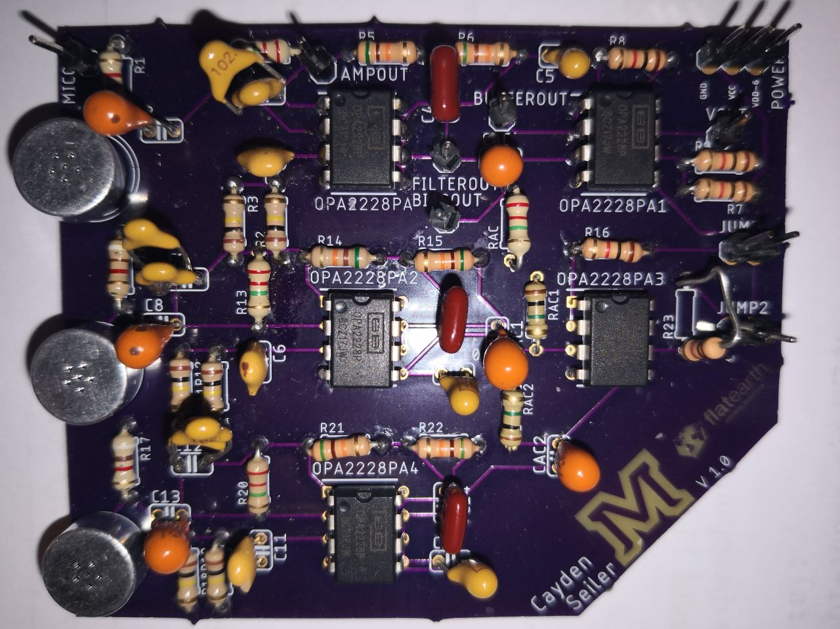
Infrasonic Wave Detection (20) Prototype Rollout
Tim Amish, Kyle Eaton, Khristian Jones, Louis Rosenblum, Cayden Seiler
Notes:
Kyle | This presentation is the prototype rollout for group 20, infrasound wave detection. Our group members are Tim Amish, Kyle Eaton, Khristian Jones, Louis Rosenblum, and Cayden Seiler. Our project is sponsored by Flat Earth and our project advisor is Dr. Ross Snider.

Slide 2
Team Goal Statement
It is difficult and expensive to detect infrasound. Therefore, an infrasonic detection system will be designed with a final detector cost of less than $100.
Notes:
Kyle

Slide 3
Design process
Microphone Choice
Signal Conditioning Chain
Pole Design
Circuit Design
Troubleshooting
Notes:
Tim

Slide 4
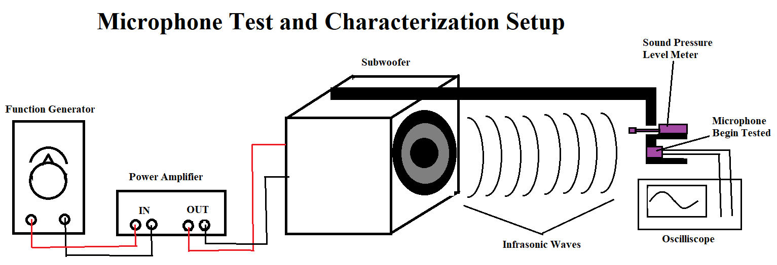
Microphone Choice
Notes:
Tim - The first step in the project was setting up a Subwoofer to operate at 10 Hz. In the first semester we found that electret microphones would have the highest chance of success. For semester two we purchased the top performing microphones to test. The test was relatively simple containing the subwoofer, SPL meter and oscilliscope. The microphone with the largest output was chosen to be the microphone the circuit was to be designed around.

Slide 5
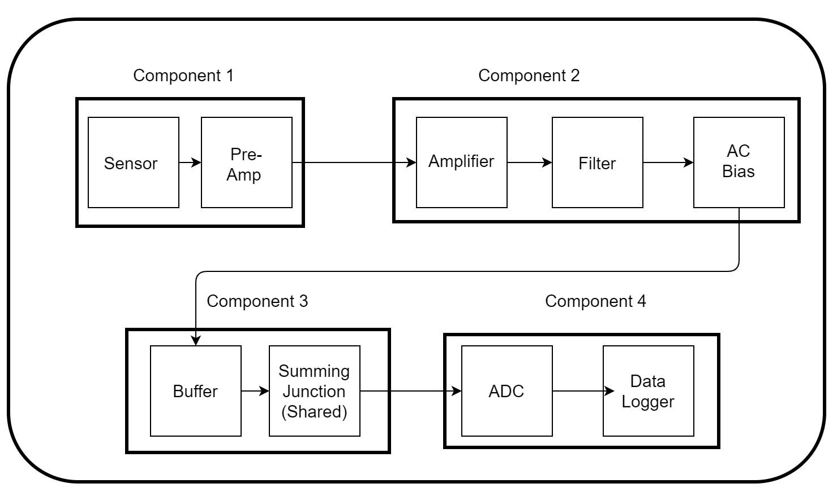
Signal Conditioning Chain
Notes:
Tim - This is the final signal conditioning chain. This was designed using Analog Devices and Texas Instruments documentation.

Slide 6
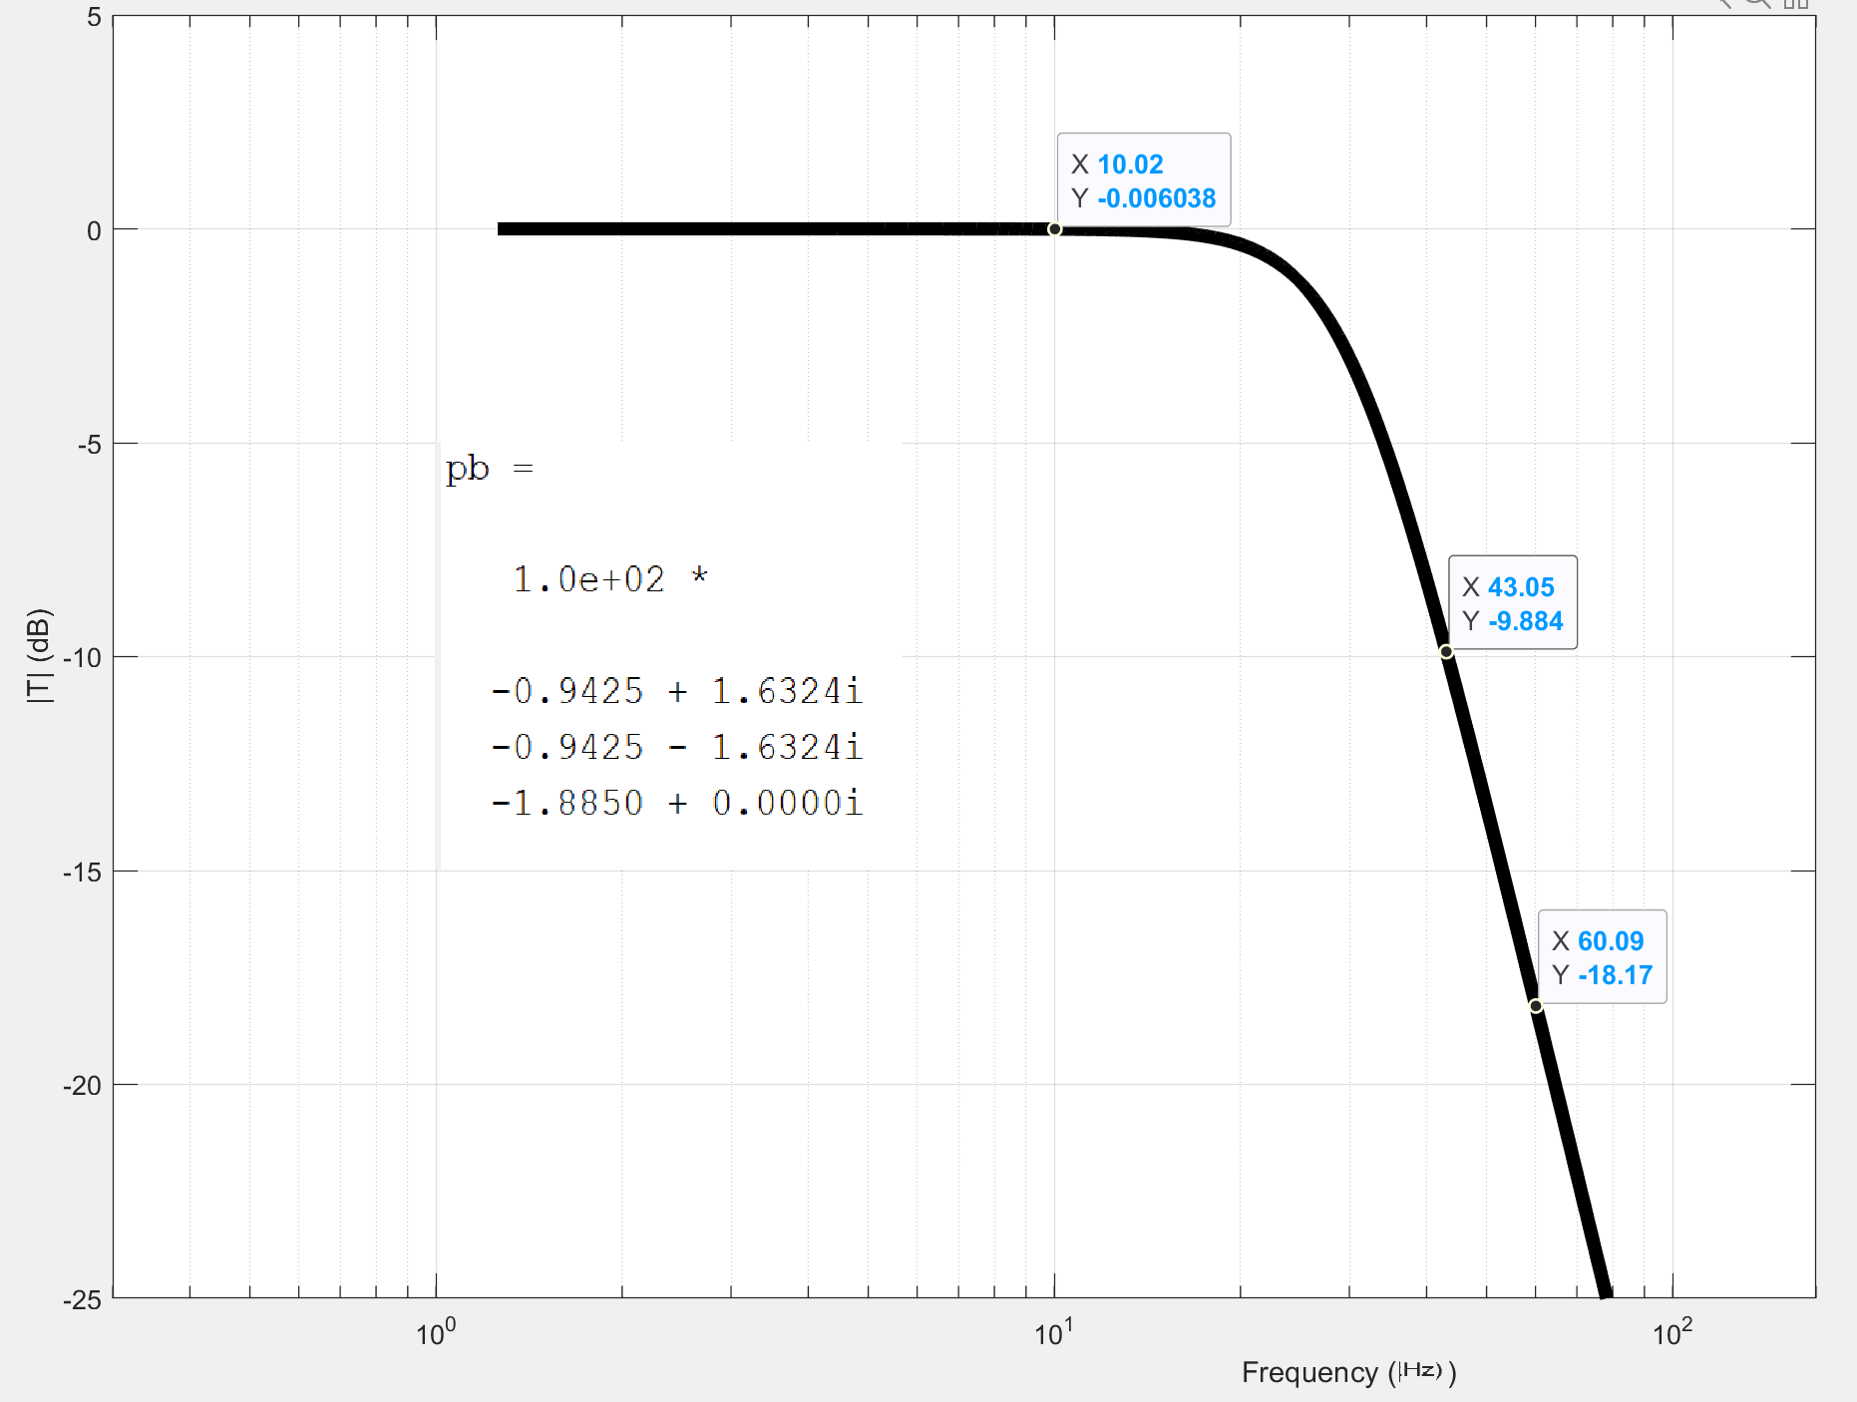
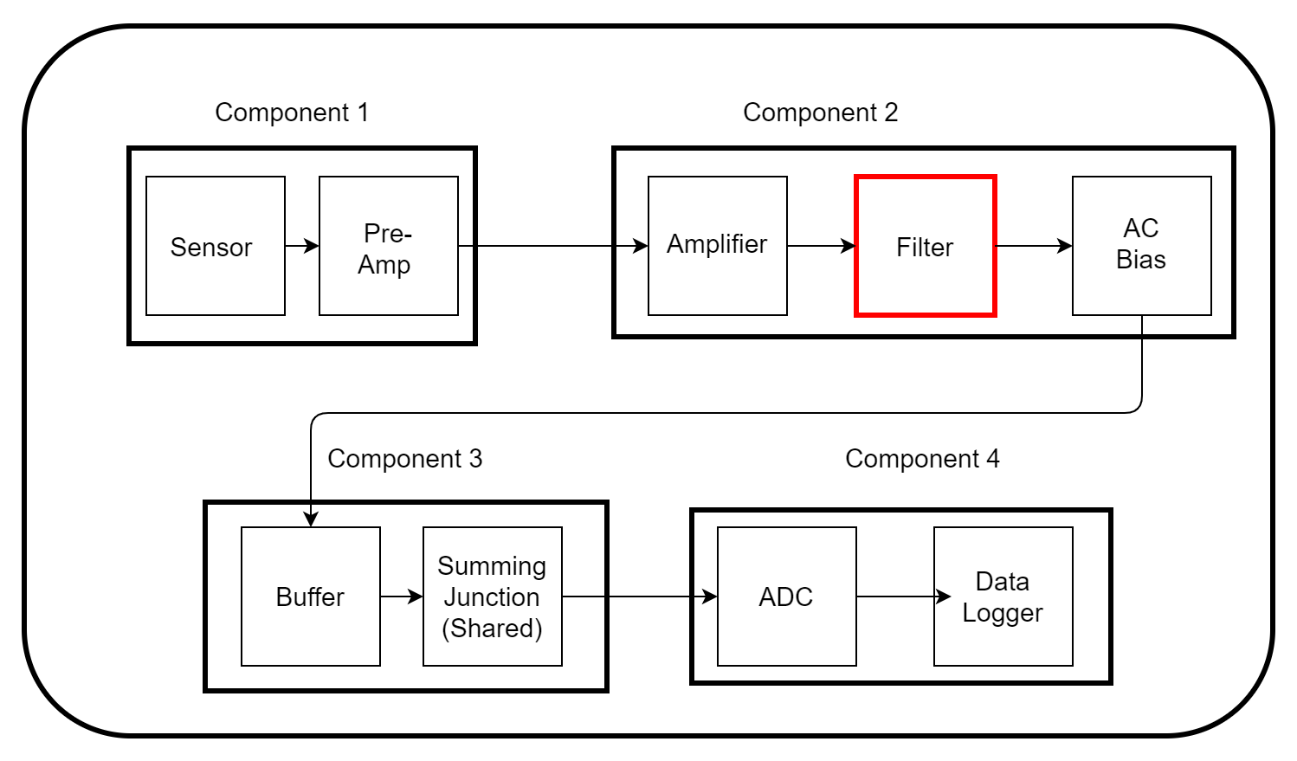
Pole Design
Notes:
Tim - The next step was to observe the microphone output and find out what kind of filtering is necessary. As will be shown in a few slides the primary noise contribution comes from 60Hz. A three butterworth filter with a corner frequency of 30Hz will insure that any 60Hz component is filtered out with an about -18dB gain. The above figure was made using MatLab code given in one of Dr. Dickensheet’s classes.

Slide 7
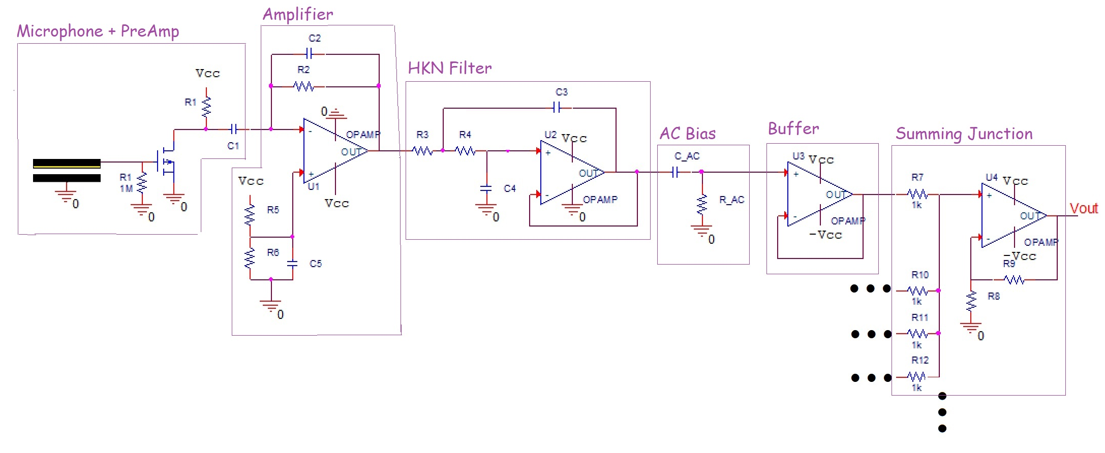
Circuit Diagram
Notes:
Tim

Slide 8
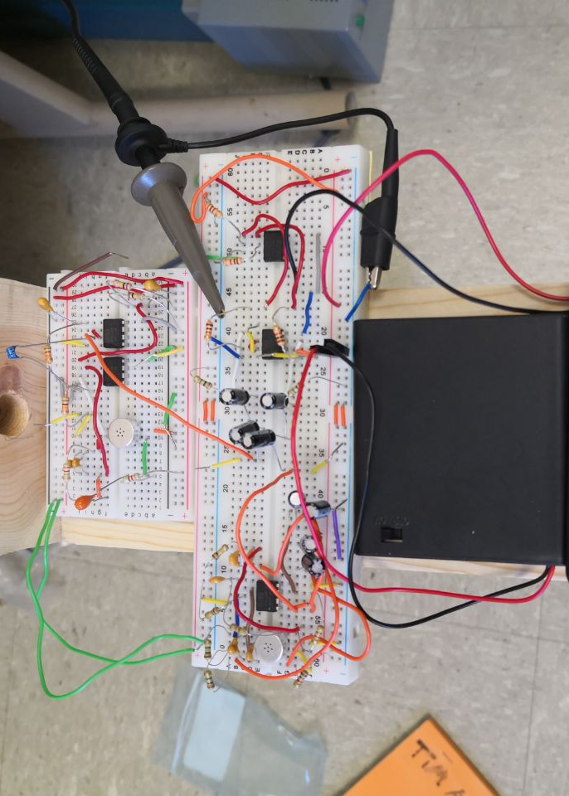
Troubleshooting
Notes:
Tim

Slide 9
Sensor Side Requirements
An infrasound detector cannot cost more than $100.
The sensor must be sensitive enough to detect a 100 dB SPL source from a distance of 1,000 meters.
The sensor must be sensitive to 10 Hz audio signals.
Notes:
Kyle

Slide 10
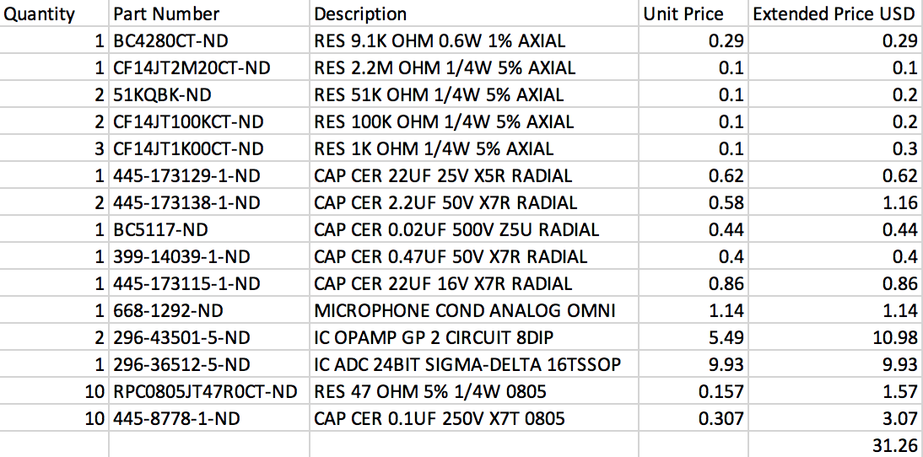
Completion of Requirement 1
Notes:
Kyle | This slide shows a cart from an electronics retailer. The cart consists of different resistor and capacitor values, which are used in the signal conditioning datapath. There is also an ADC included in this list. The first requirement states that an individual detector must be under $100. With all of the parts in the cart, the total is $31.26 without shipping. This means that when buying the components at individual pricing as opposed to bulk orders, the final detector price is well under $100. It is important to note that the printed circuit board price is not included. This is because the printed circuit board was not a requirement from our sponsor. For three boards for , the price was $36, so when adding this to the other price, the total is still less than $100.

Slide 11
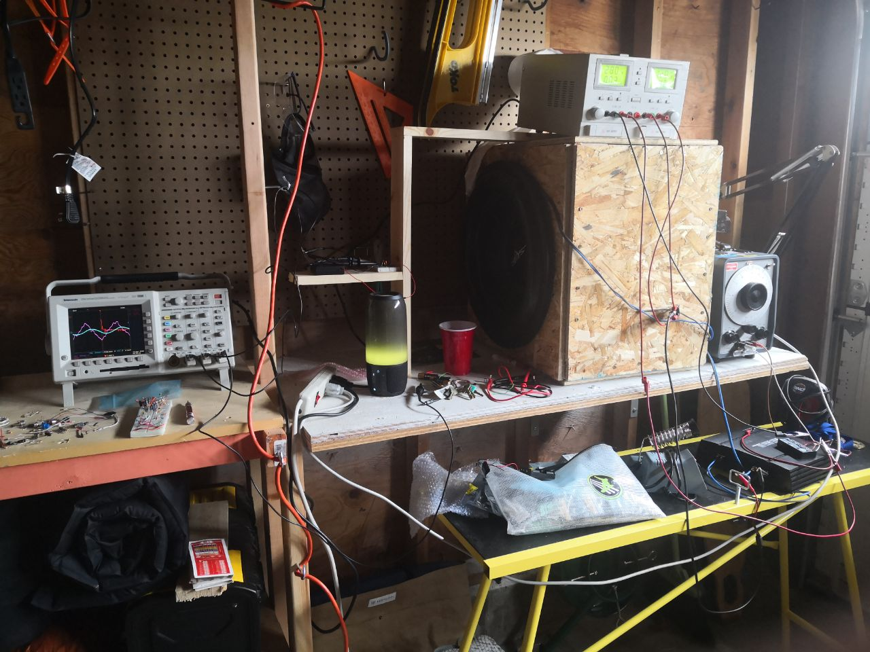
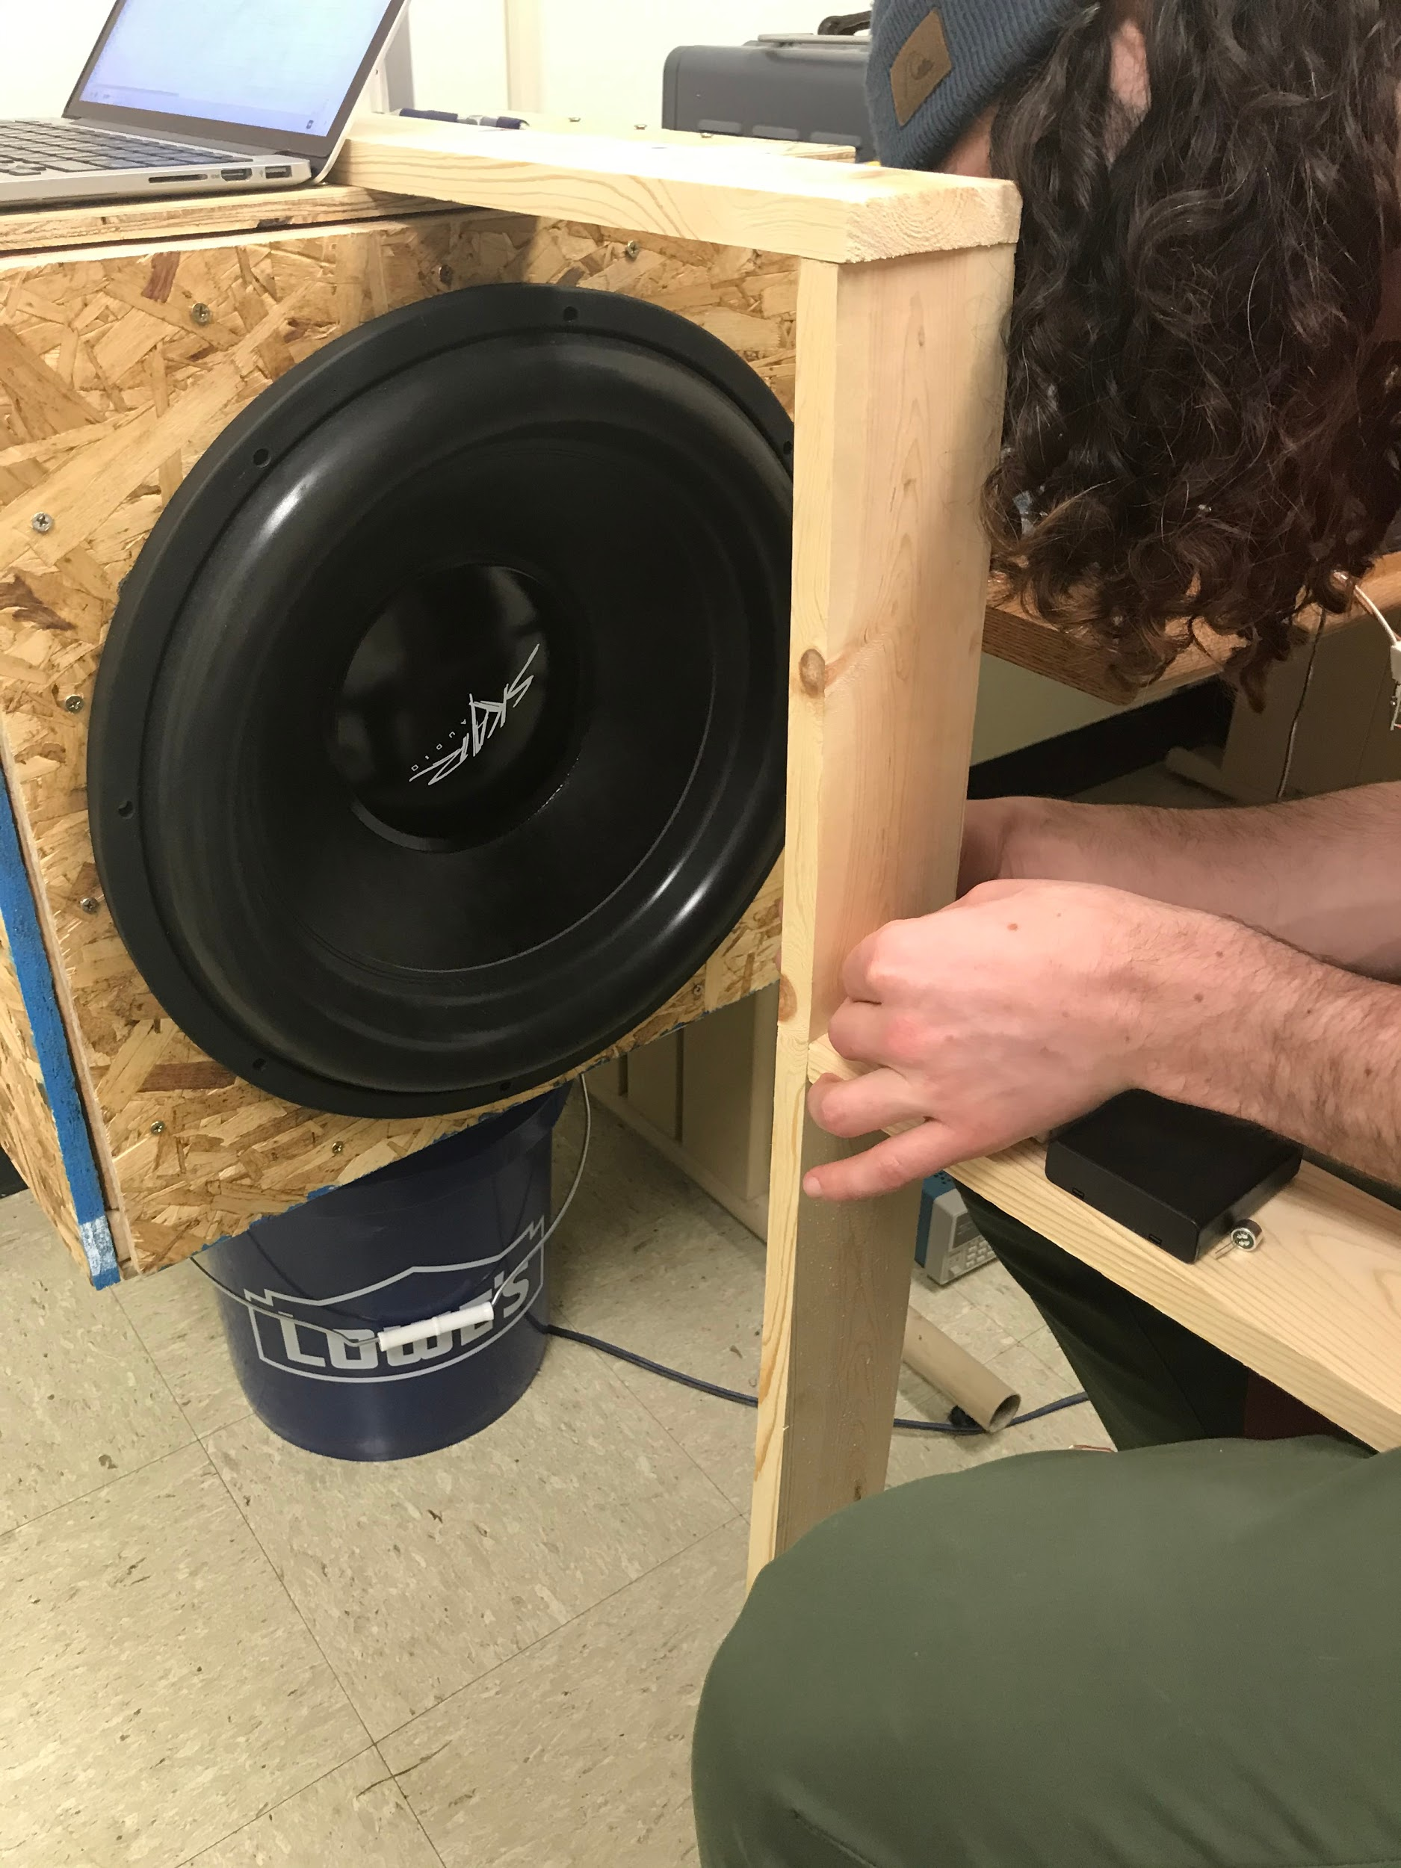
Completion of Requirement 2
Notes:
Kyle | The second requirement was to be able to detect a 100 dB SPL source from 1000 m away. From the first semester phase of this project, we determined that the 100 dB SPL source attenuated down to around 70 dB. Dr. Maher lent us a sound pressure level meter and we were able to determine that the room we were in was producing 76 dB of low frequency noise. The meter was placed on the horizontal board and the actual pressure sensitive portion sat flush with the vertical board. This low frequency noise was detected even when the subwoofer was not running. We tried making the measurement with the HVAC off and the same amount of noise was measured by the meter. Instead of building a noiseless chamber, our sponsor suggested that we are within a reasonable range of 70 dB. We did not take a picture of the measurement on the meter and we are unable to get the meter back, so you will just have to trust us.

Slide 12
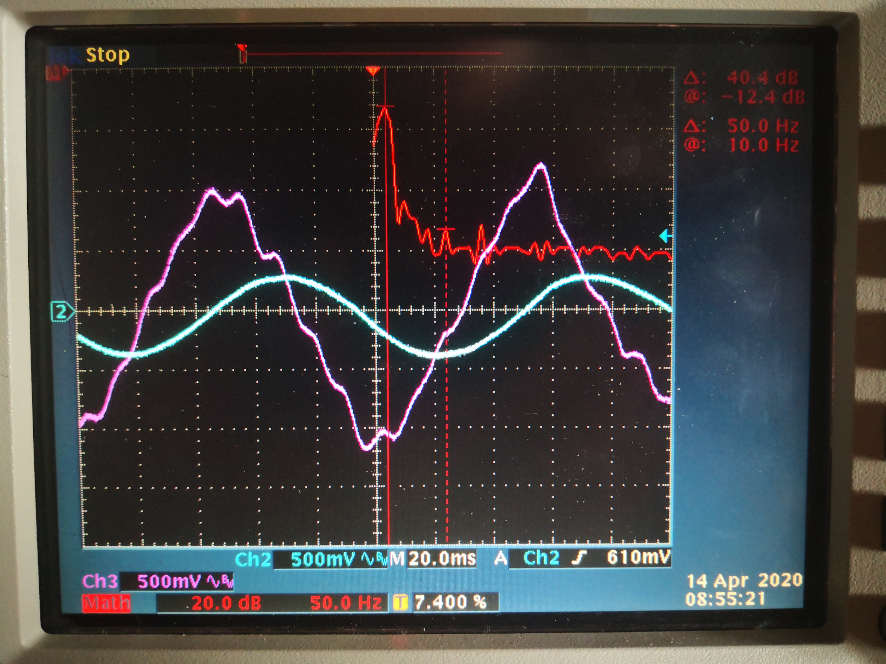
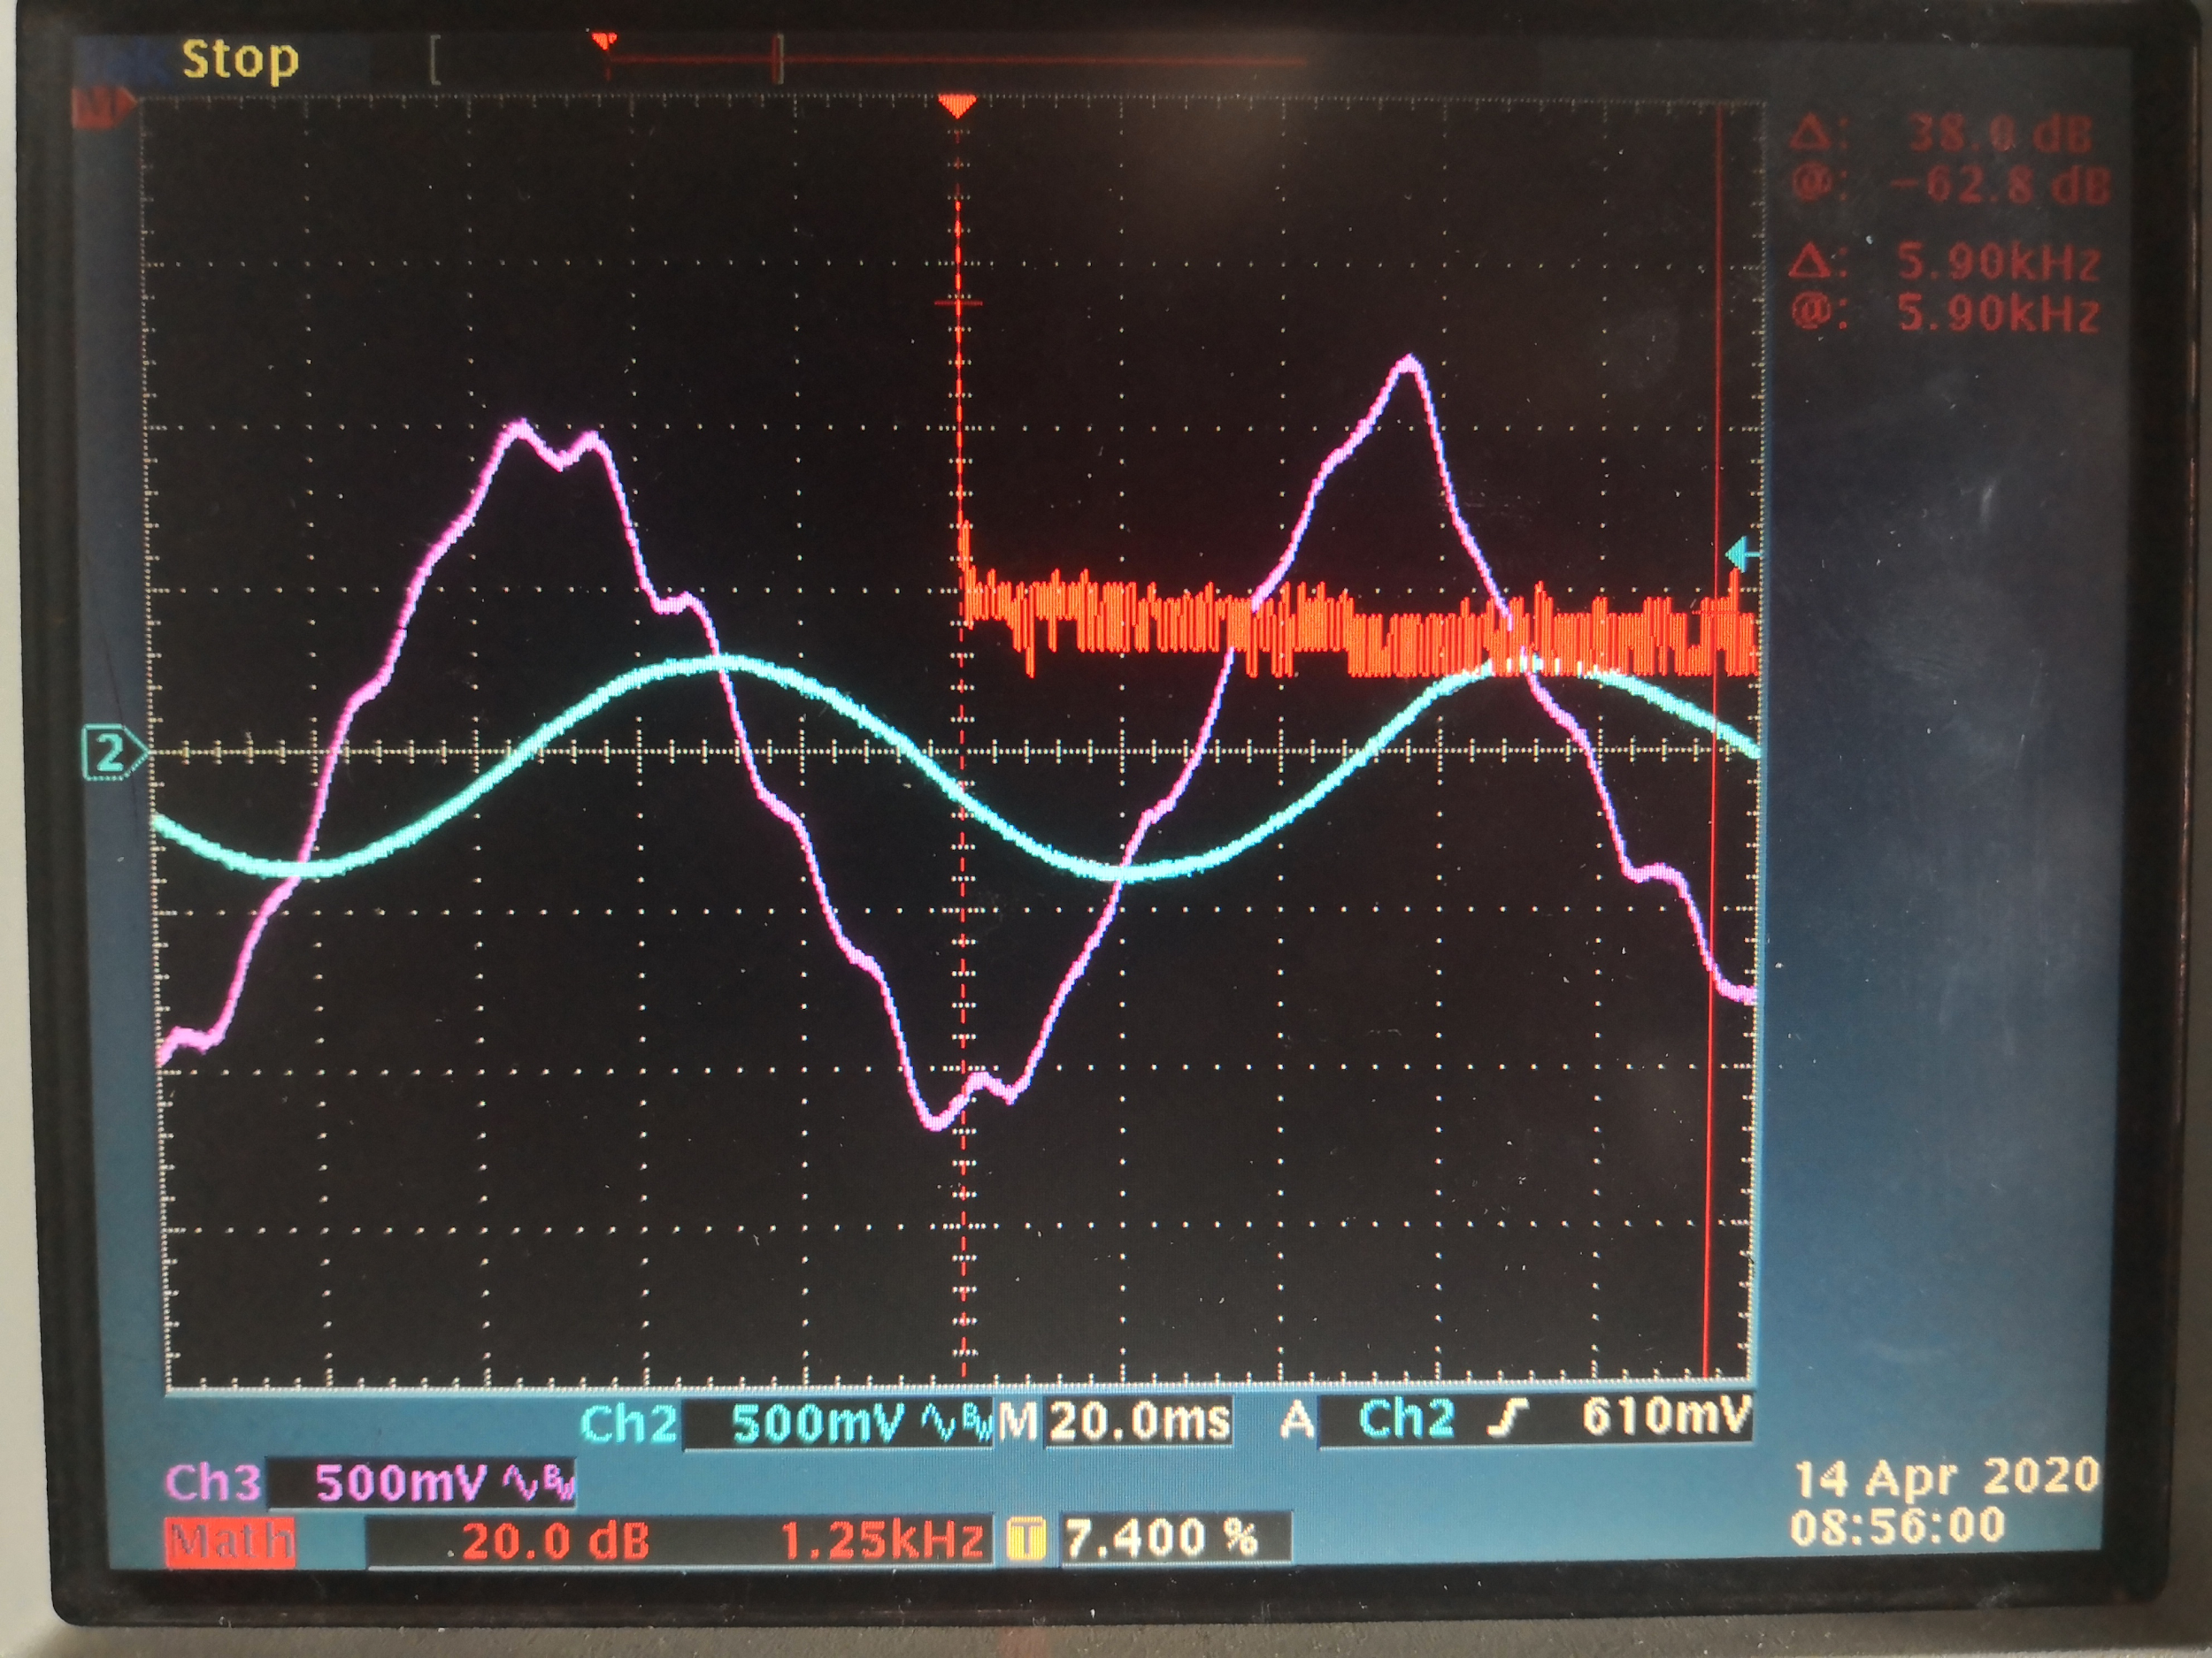
Completion of Requirement 3
Notes:
Tim | The third requirement states that the sensor must be sensitive to 10 Hz audio signals. Looking at a screenshot of the waveform, you can see that that there is a cursor over the largest peak of the FFT. If one looks to the upper right hand corner of the oscilloscope screen the frequency component is in red next to the @ symbol and it is at 10 Hz. Therefore, all of the other portions of the FFT are just noise, but the biggest waveform is the 10 Hz component which satisfies requirement 2.

Slide 13
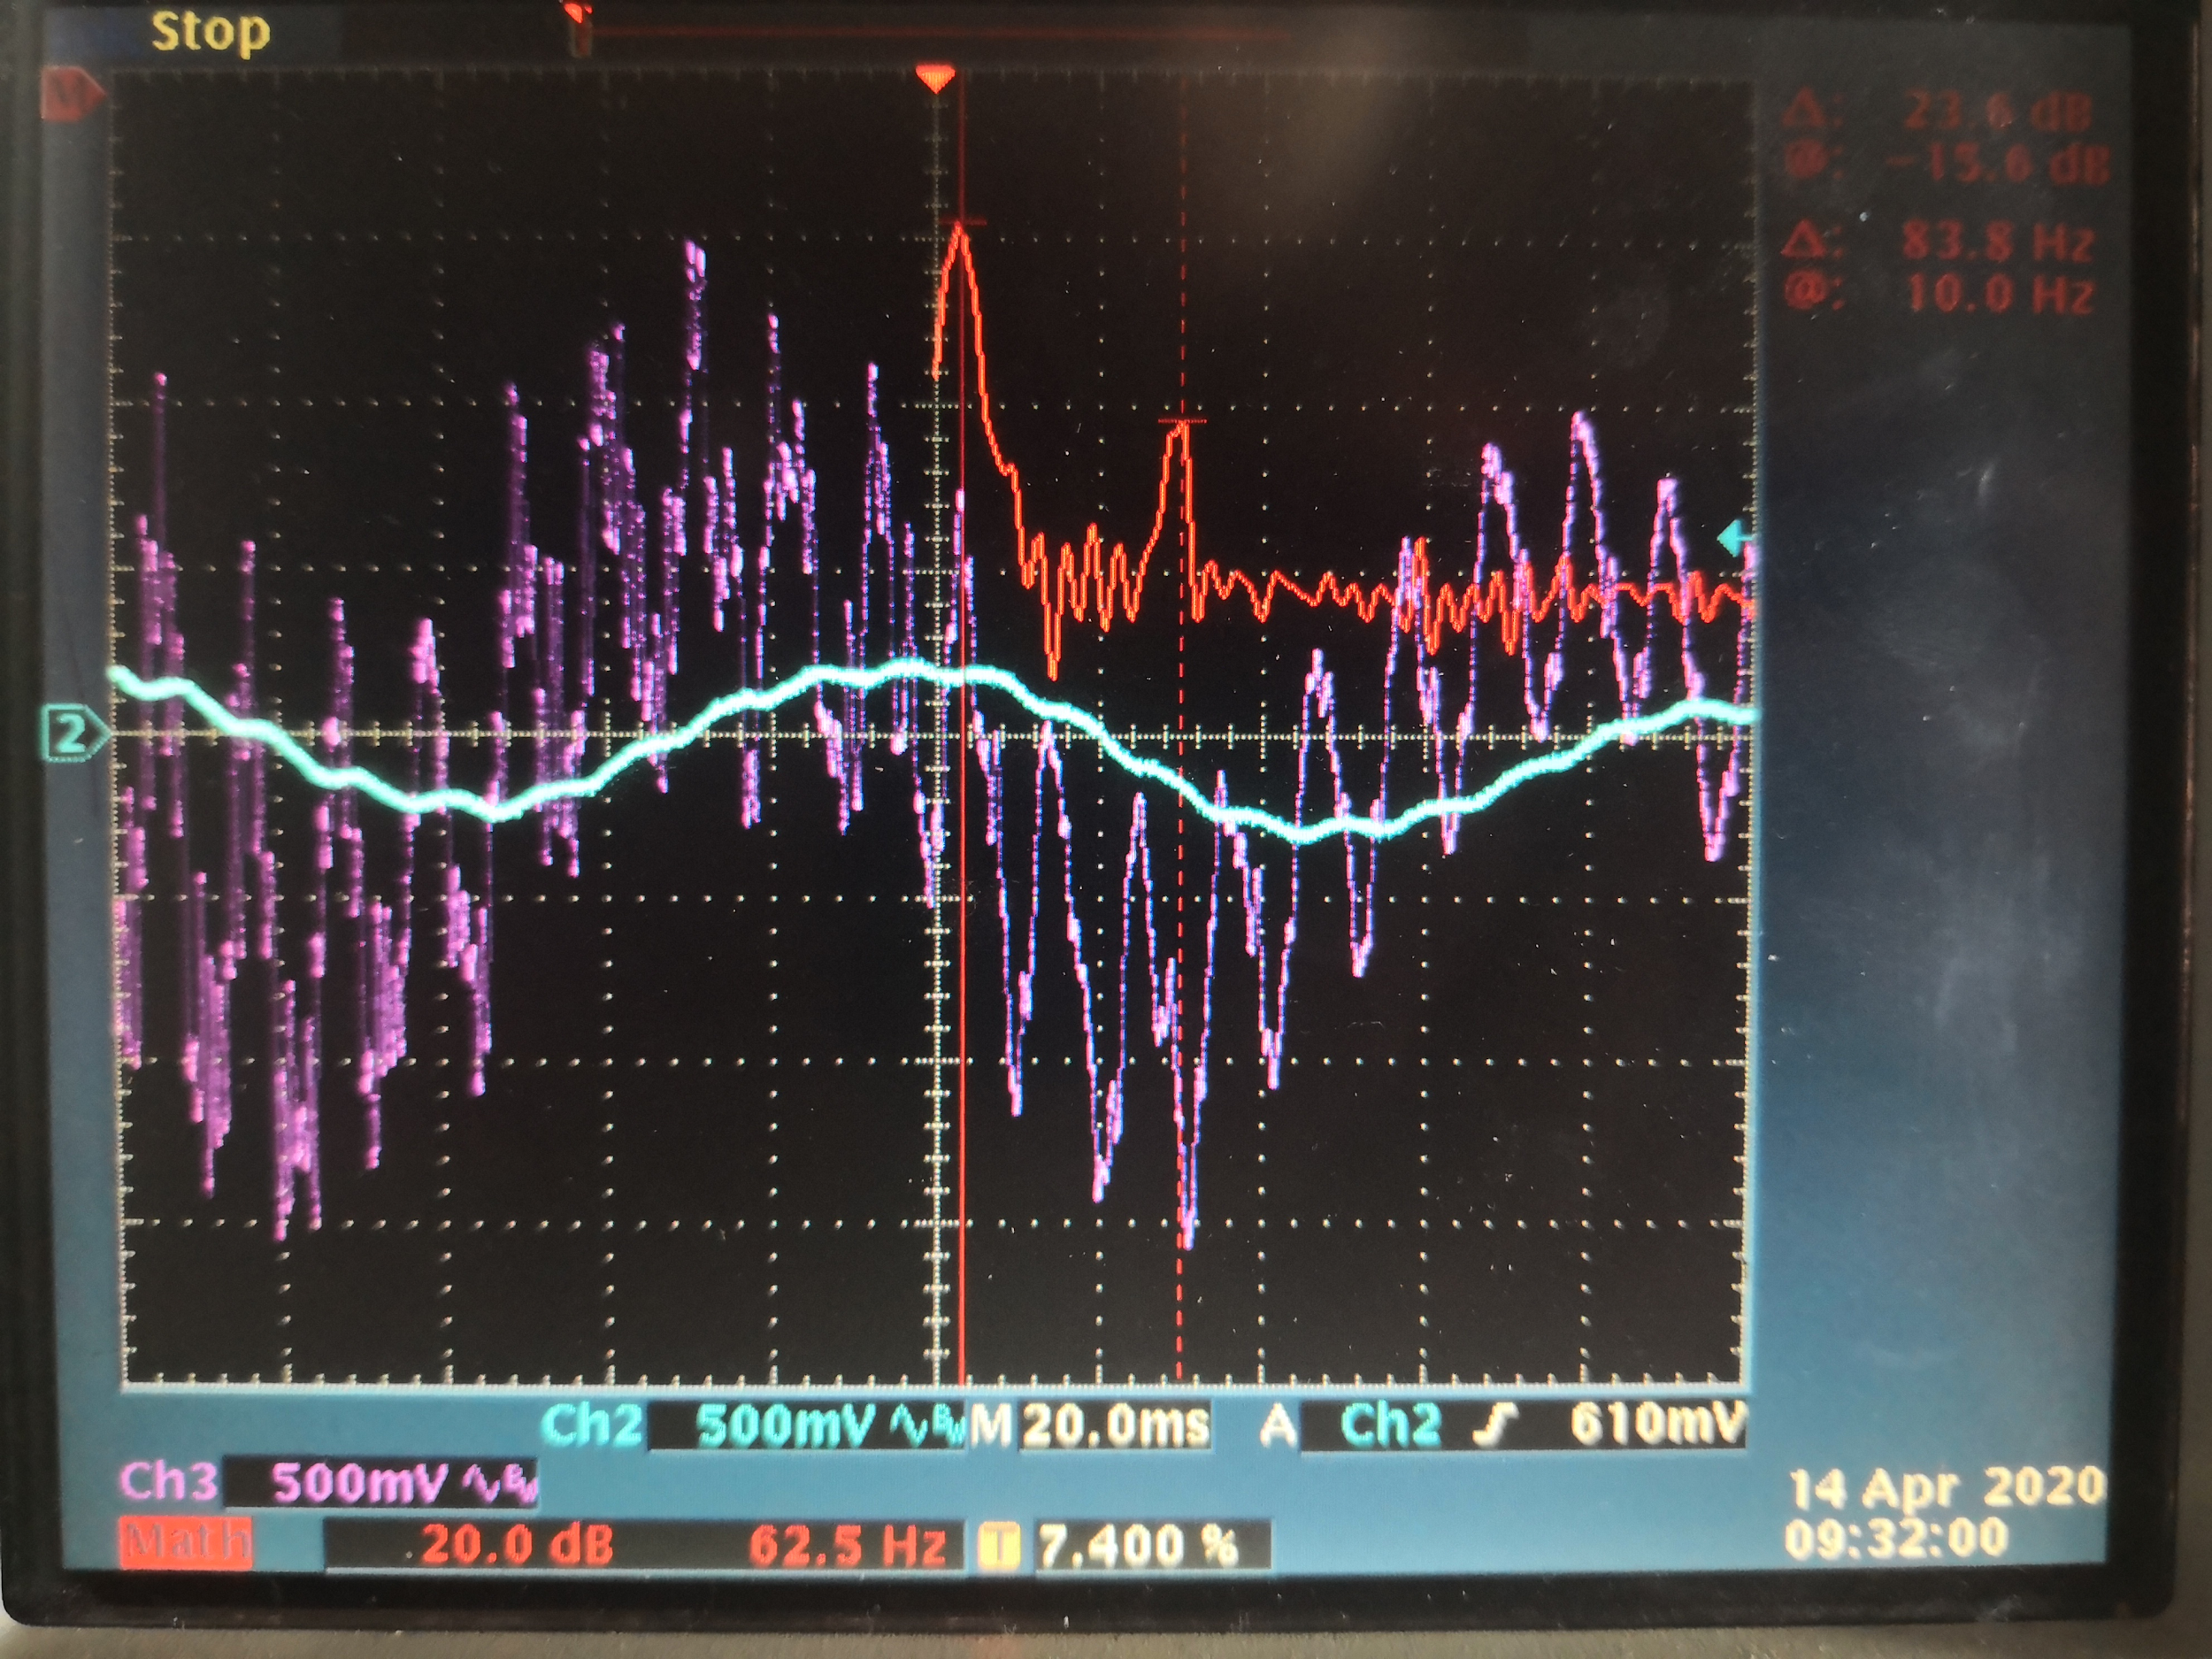
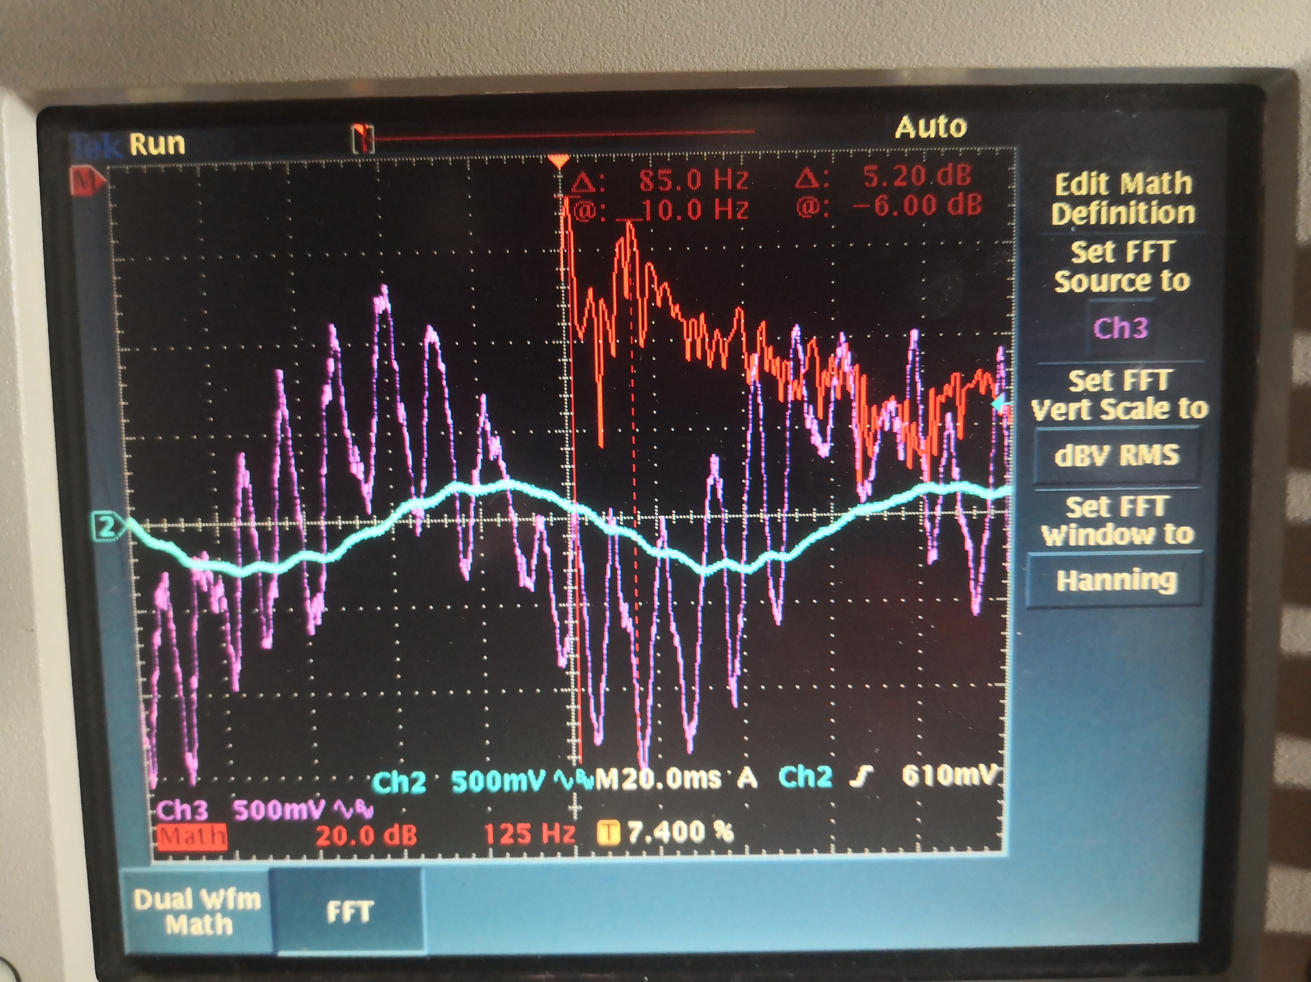
Noise reduction
Notes:
Tim -> That peak ~ 120Hz which is in the male voice frequency range

Slide 14
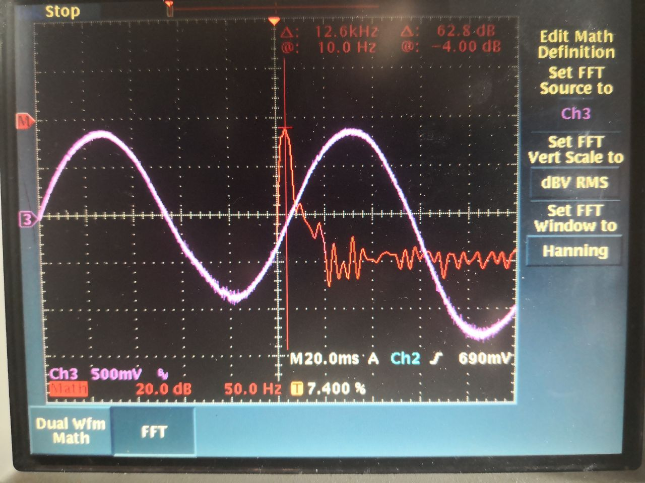
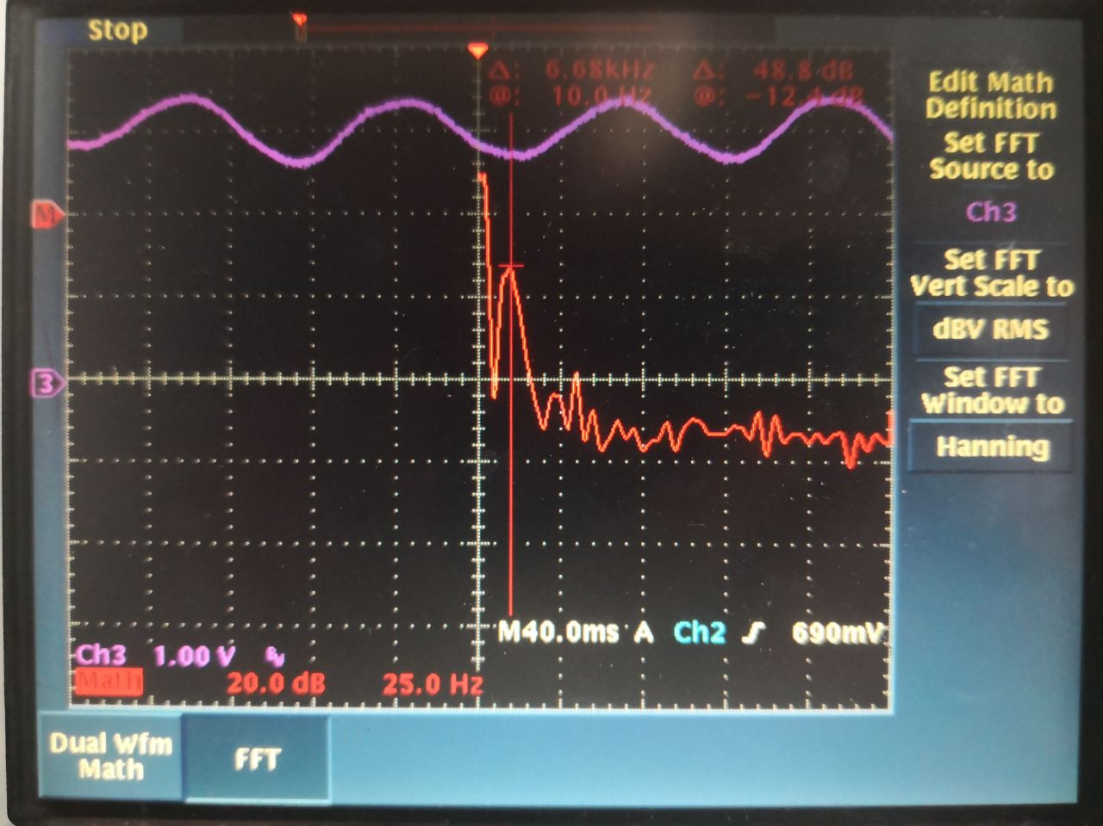
Not Covered by Requirements
Notes:
Tim

Slide 15
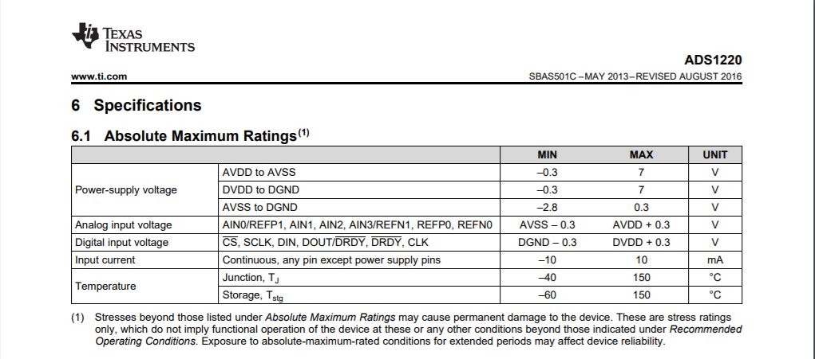
Input Voltage of ADC
Notes:
Cayden
The analog input voltage of the ADC depends on the values of power-supply. Thus with a power supply of 0V and 6V, our maximum input values can be between -.3V and 6.3V for AVSS and AVDD respectively. DVDD will be drawn from the arduino board to maintain that the output, DOUT, is not too high of a voltage for our microcontroller. AVSS and DGND are also connected at a single point to satisfy that specification. With our typical maximum amplitude of our filtered signal from a single datapath being .5V, a DC bias of 3V will be used to ensure that the signal is halfway between our analog power-supply when there are 3 summed signals like in the PCB design. Enabling any drastic spikes in voltage to be handled.

Slide 16
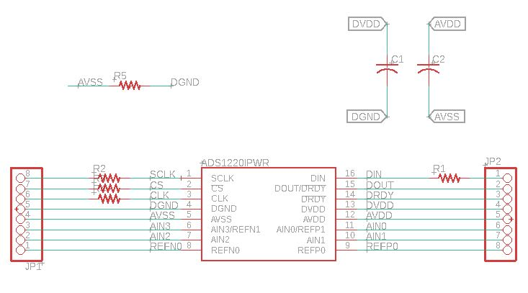
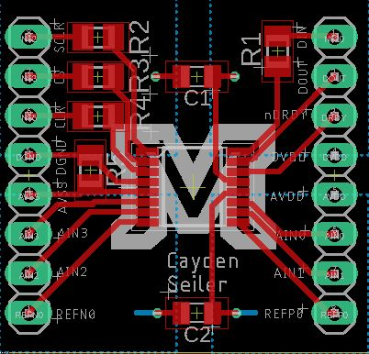
ADC
Notes:
Cayden
Unfortunately there were some troubles with the ADC. The first board that was purchased took a month to arrive from India and had AVDD and DVDD shorted together . After discovering the shorted line and thinking that it could potentially take longer once the Corona virus starts picking up I decided to just develop my own based on the example diagram from the datasheet. That led to the schematic and board on the slide. Unfortunately before even this board and components got here, campus and the labs closed.

Slide 17
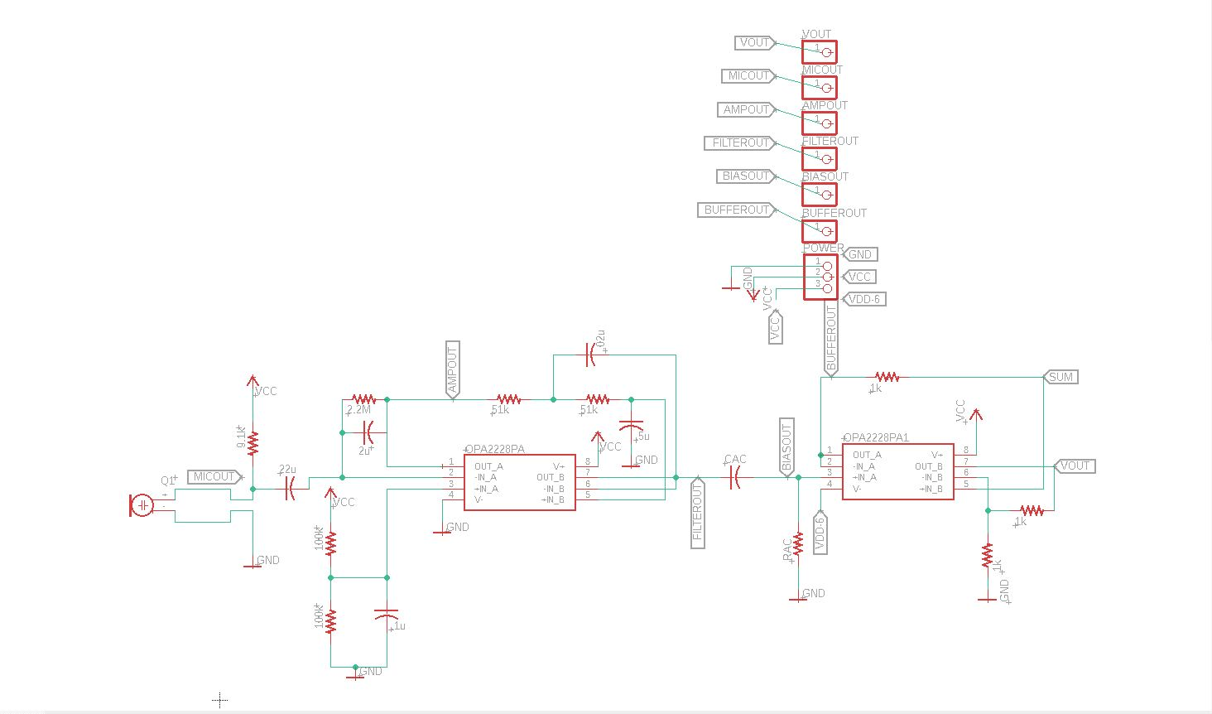
PCB Design
Notes:
Cayden
Originally the design was to be done in Altium, Eagle was used instead however as it was faster and allowed for easier revisions of the design. The schematic on screen shows one signal conditioning path from the microphone to Vout. The final design has 3 conditioning paths converging into the summing junction. After this initial path every two paths adds 3 operational amplifiers leading us to choose three paths per board as it saved space and money on components while still allowing us to show the boosted signal to noise ratio after summing. As this section was the main conditioning path test points were added to make sure the conditioning path was working as expected. The operational amplifiers we used fortunately had an Eagle component that allowed me to get a feel for how I wanted to place the resistors and capacitors on the board.

Slide 18
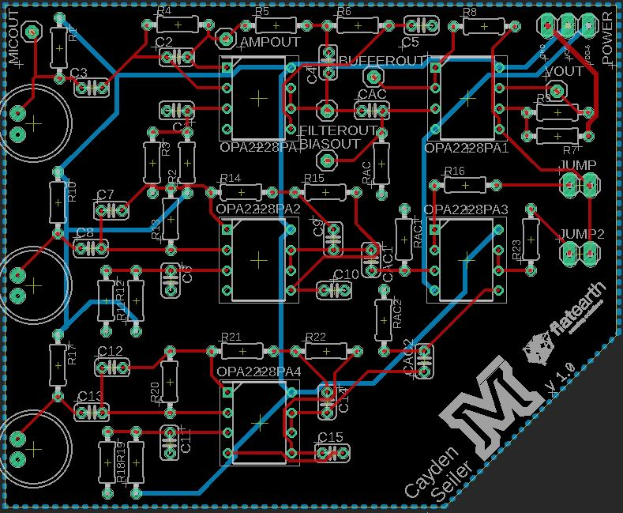
Notes:
Cayden
The layout for the PCB is shown on this slide. It is a pretty standard design with a bottom layer ground plane and power traces. We decided to go with through hole instead of surface mount as we already had the components in wire lead form and decided that it would be easier. Luckily for us that was a good decision as the board arrived after the Covid-19 campus closures. And with those closures, our ability to reach a soldering iron with an attached microscope and small enough soldering tip to comfortably solder surface mount components was severely limited. A little demonstration we had planned to do during the design fair was to use jumper cables to demonstrate how adding signals can increase our signal to noise ratio. That was the purpose of the two jump locations on the right side of the board.

Slide 19
Detection Engine Requirements
Requirements:
4. Must identify an infrasonic (10Hz) signal in presence of noise
5. Must use data from four or more sensors
6. Must be able to delay sensor data independently. Able to simulate listening
to a specific locations by setting phase delays
7. Must indicate signal presence in noise. Detection threshold set using signal
detection theory).

Slide 20
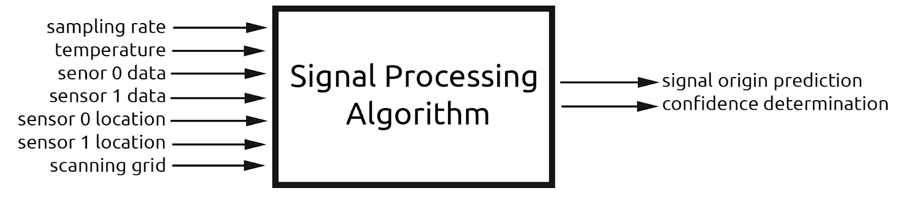
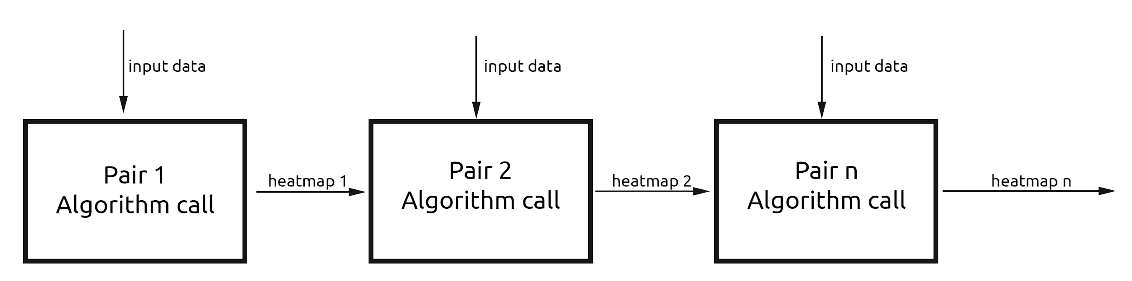
Detection Engine Algorithm
Algorithm interprets sensor data to predict whether an infrasonic signal is present
The algorithm operates on signals from 2 sensors. The algorithm is performed for each possible combination of 2 sensors (i.e. 4 sensors -> 6 combinations).
Notes:
Khristian
To meet our objectives, we have designed a detection engine algorithm that will determine if an infrasonic signal is present. The detection engine algorithm is a subcomponent of our Matlab simulation. The algorithm will utilize a beamforming process to maximize the constructive interference of a propagating signal. Beamforming is a spatial filtering technique used to isolate signals of interest. In this case, the propagating signal is a 10 HZ sinusoid, originating from some unknown location. The propagating signal will be received by multiple sensors, each placed in a different location. The sensors are divided up into every possible combination of pairs. Within each pair, one is used as an unaltered reference sensor, while the other will be phase delayed. These phase delays are used to identify signal origin location. After being delayed, the reference signal data and the delayed signal data are then summed together. This operation is conducted for each pair of sensors, across all possible delays. The resulting summation is compared to a threshold and from there, the highest resulting summating can be identified as the true signal origin.

Slide 21
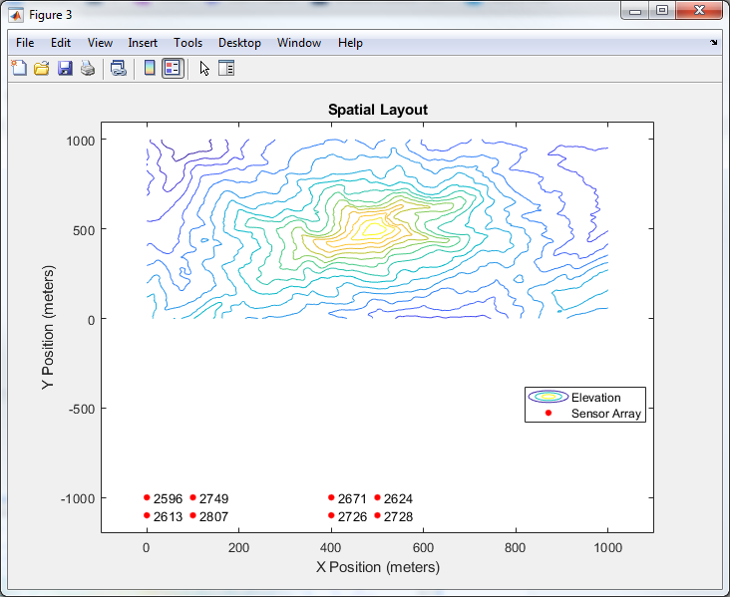
MATLAB Simulation
Testbench built to verify detection engine design
1 km x 1 km scanning region (contour area)
8 total sensors placed 1 km south of scanning region southern border
Signal propagates from random point in scanning grid and detection engine will use sensor data to predict signal presence
Notes:
Khristian
The simulation to test this algorithm stems from real world application of avalanche detection. While not necessary, we believed it was in best interests to model our simulation after a real world scenario. The scenario we are modeling is an avalanche occurring on one of the faces of Lone Peak in Big Sky Montana. A 1 KM X 1 KM scanning region is used as the bounds of our simulation. The avalanche occurrence is represented by an impulse-like infrasonic signal occurring at a random location on the contour map. 8 total sensors are placed 1 km south of the scanning region in the southern border. These sensors are assumed to be operating under perfect conditions and are sensitive to the infrasound signal. As the signal propagates, random white gaussian noise is added to the signal. The data picked up by the sensors is used by the detection engine to predict signal presence.

Slide 22
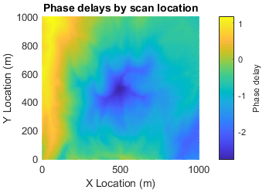
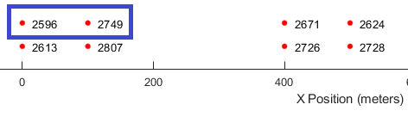
Delay and Sum Operation
Phase delays are calculated for each scanning point for every sensor combination.
Shown here are the delays for sensor 0 and sensor 1.
Notes:
Khristian
The following figure is a heat map showing the phase delay as a function of distance in the x and y. This is because the distance traveled to a specific point is different for each sensor. To “listen” to a specific point, the corresponding phase delay will be used to delay one of the sensors by that many seconds. The different color patterns you see, specifically in the center of the heat map, is due to the fluctuations in the z - direction, elevation.

Slide 23
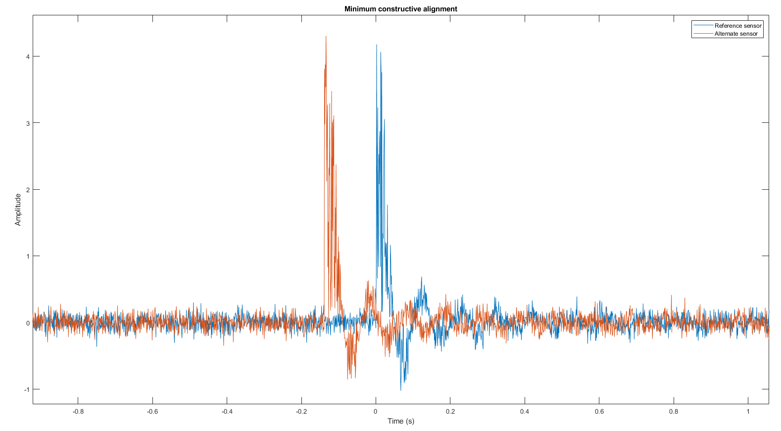
Notes:
Khristian
Here is an example of the minimum constructive alignment. In the blue is the reference sensor and the red is the sensor being phased delayed. As you can see, the signals are not clean. Random white gaussian noise has been added to the signals, and collected by the sensors. Since the signals are out of alignment, when added together the max amplitude of the summation will not be greater than our threshold.

Slide 24
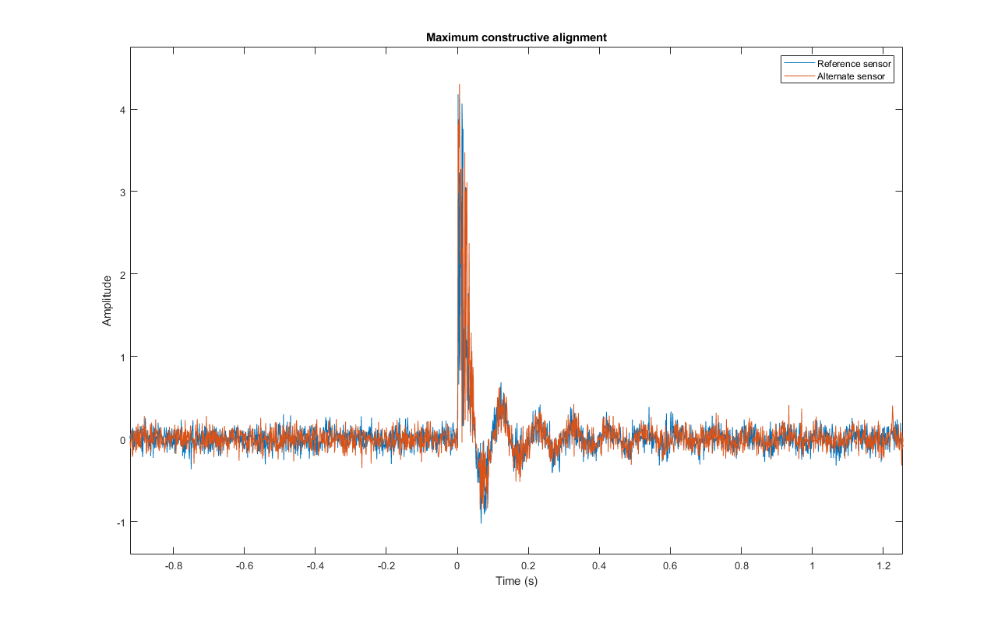
Notes:
Khristian
The next slide shows an example of maximum constructive alignment. Here the alternate sensor has been delayed by the correct amount. When these two signals are added together, the resulting summation will be greater than our threshold and will visible on our heatmap as an origin location.

Slide 25
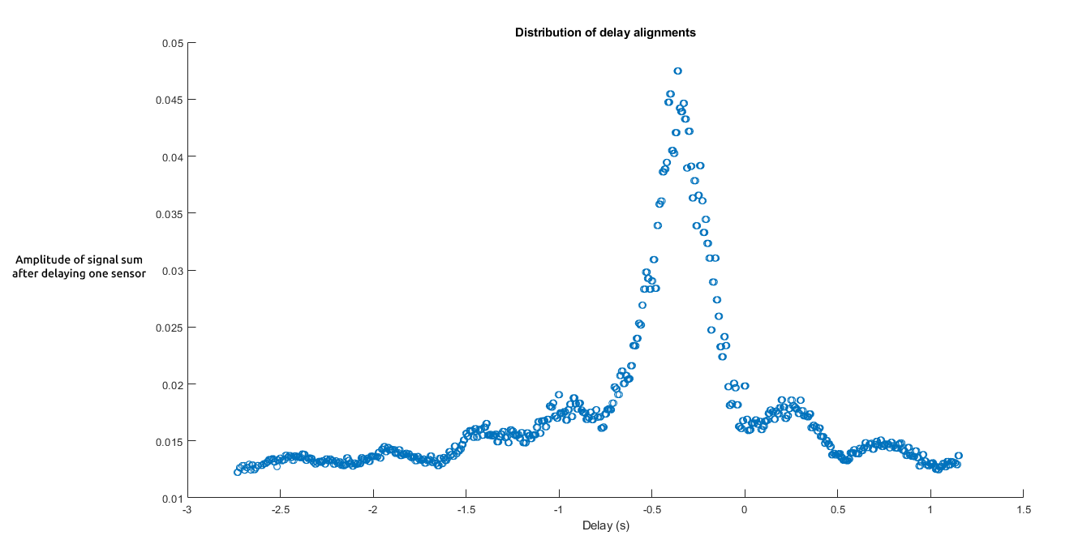
Notes:
Khristian
This is a distribution plot showing the different delay alignments and the corresponding amplitude after summation. This plot only shows delays from a single sensor pair. Notice the clear spike around the half second mark. This is the point where the incoming signals begin to align and add constructively.

Slide 26
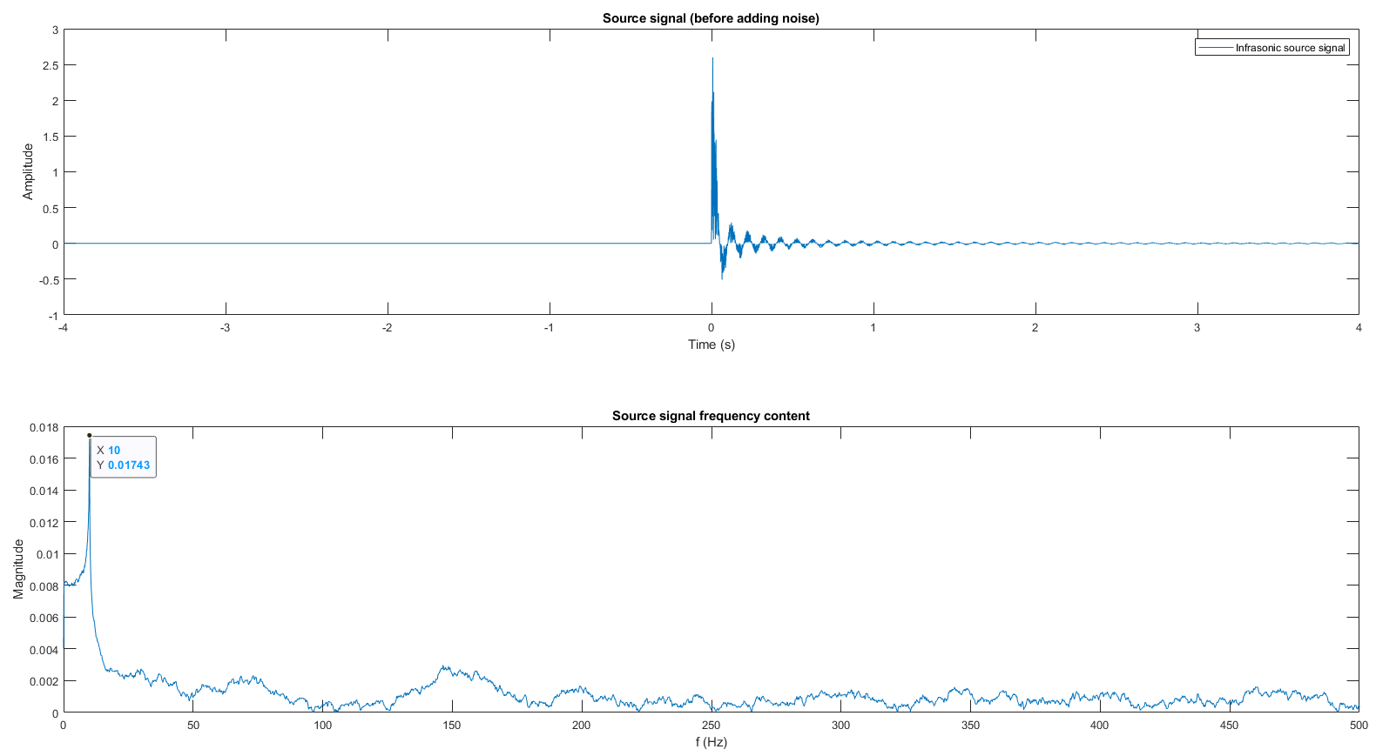
Detection test case: infrasonic signal present

Slide 27
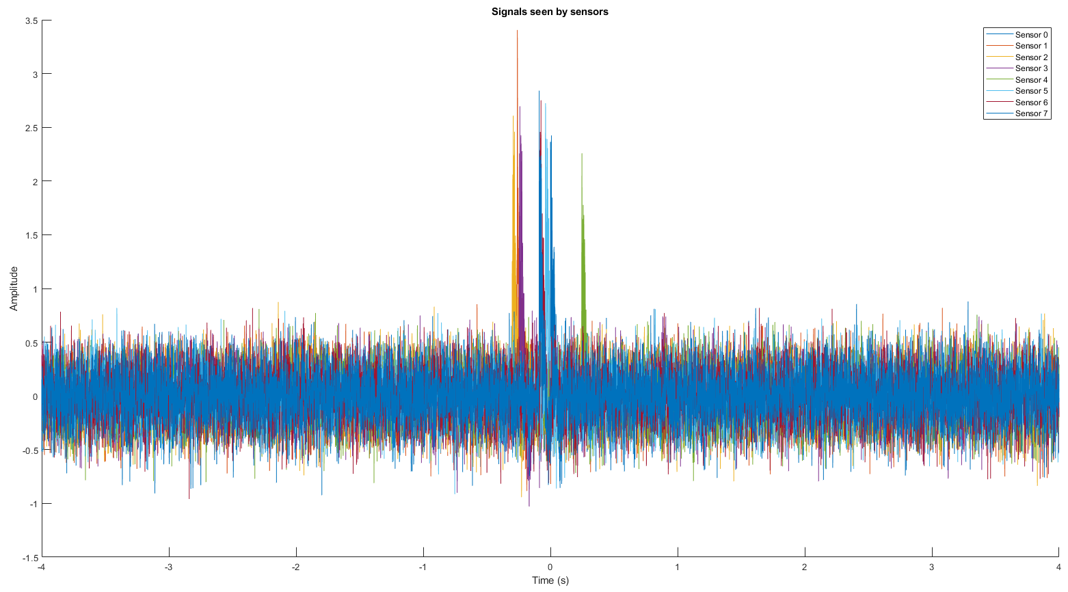
Sensor data

Slide 28
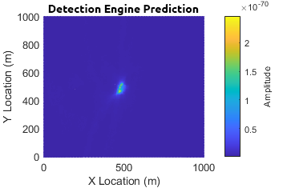
Heatmap output

Slide 29
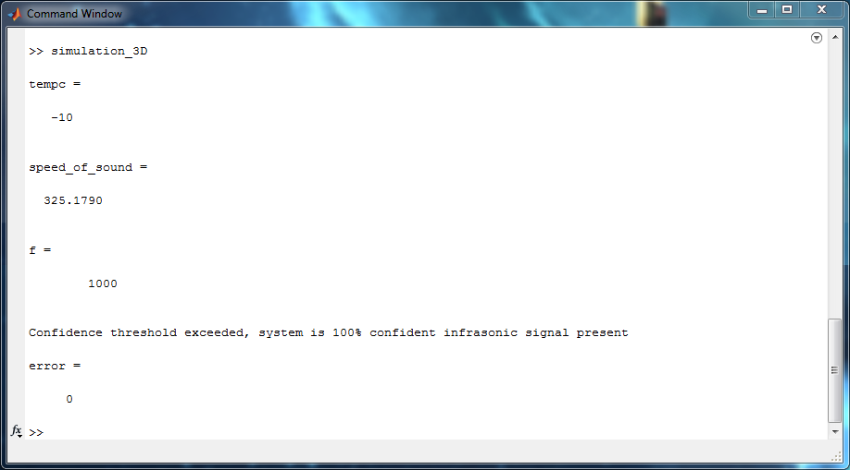
Results
System correctly predicted the presence of an infrasonic signal
System located the signal origin exactly (0 meters of error)

Slide 30
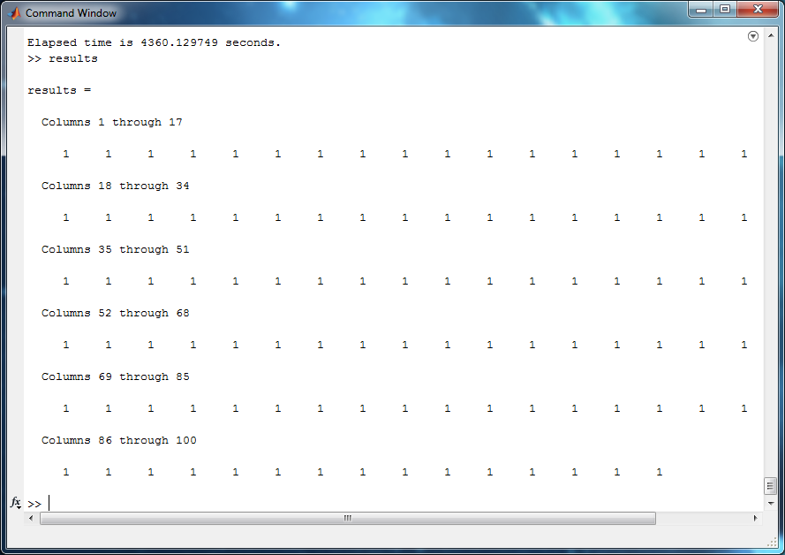
Study of 100 signal present simulations
Signal presence was detected in all 100 cases

Slide 31
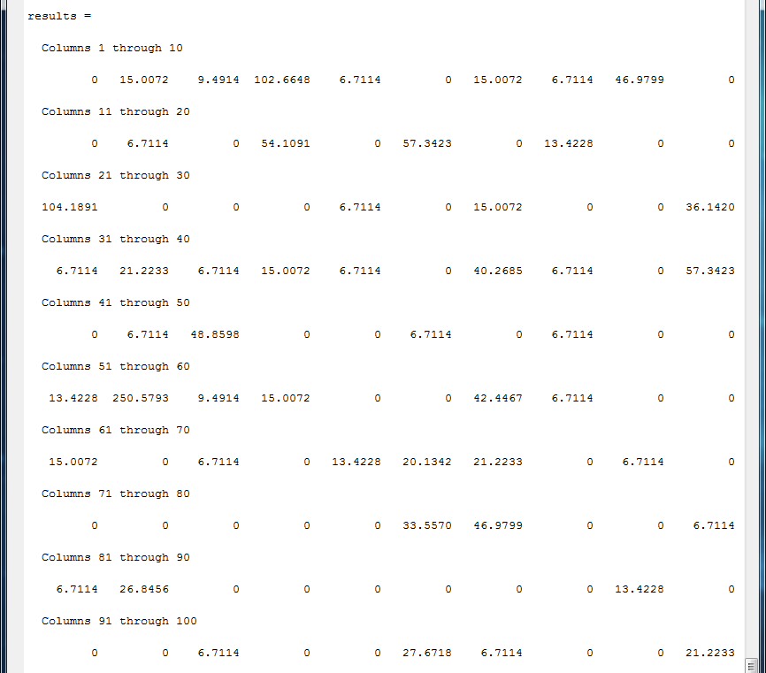
Geolocation Error
Signal origin was located with an average error of 13.4 m
Standard deviation of 30.9 m
97 of the 100 simulations, located signal origin with under 100 m of error

Slide 32
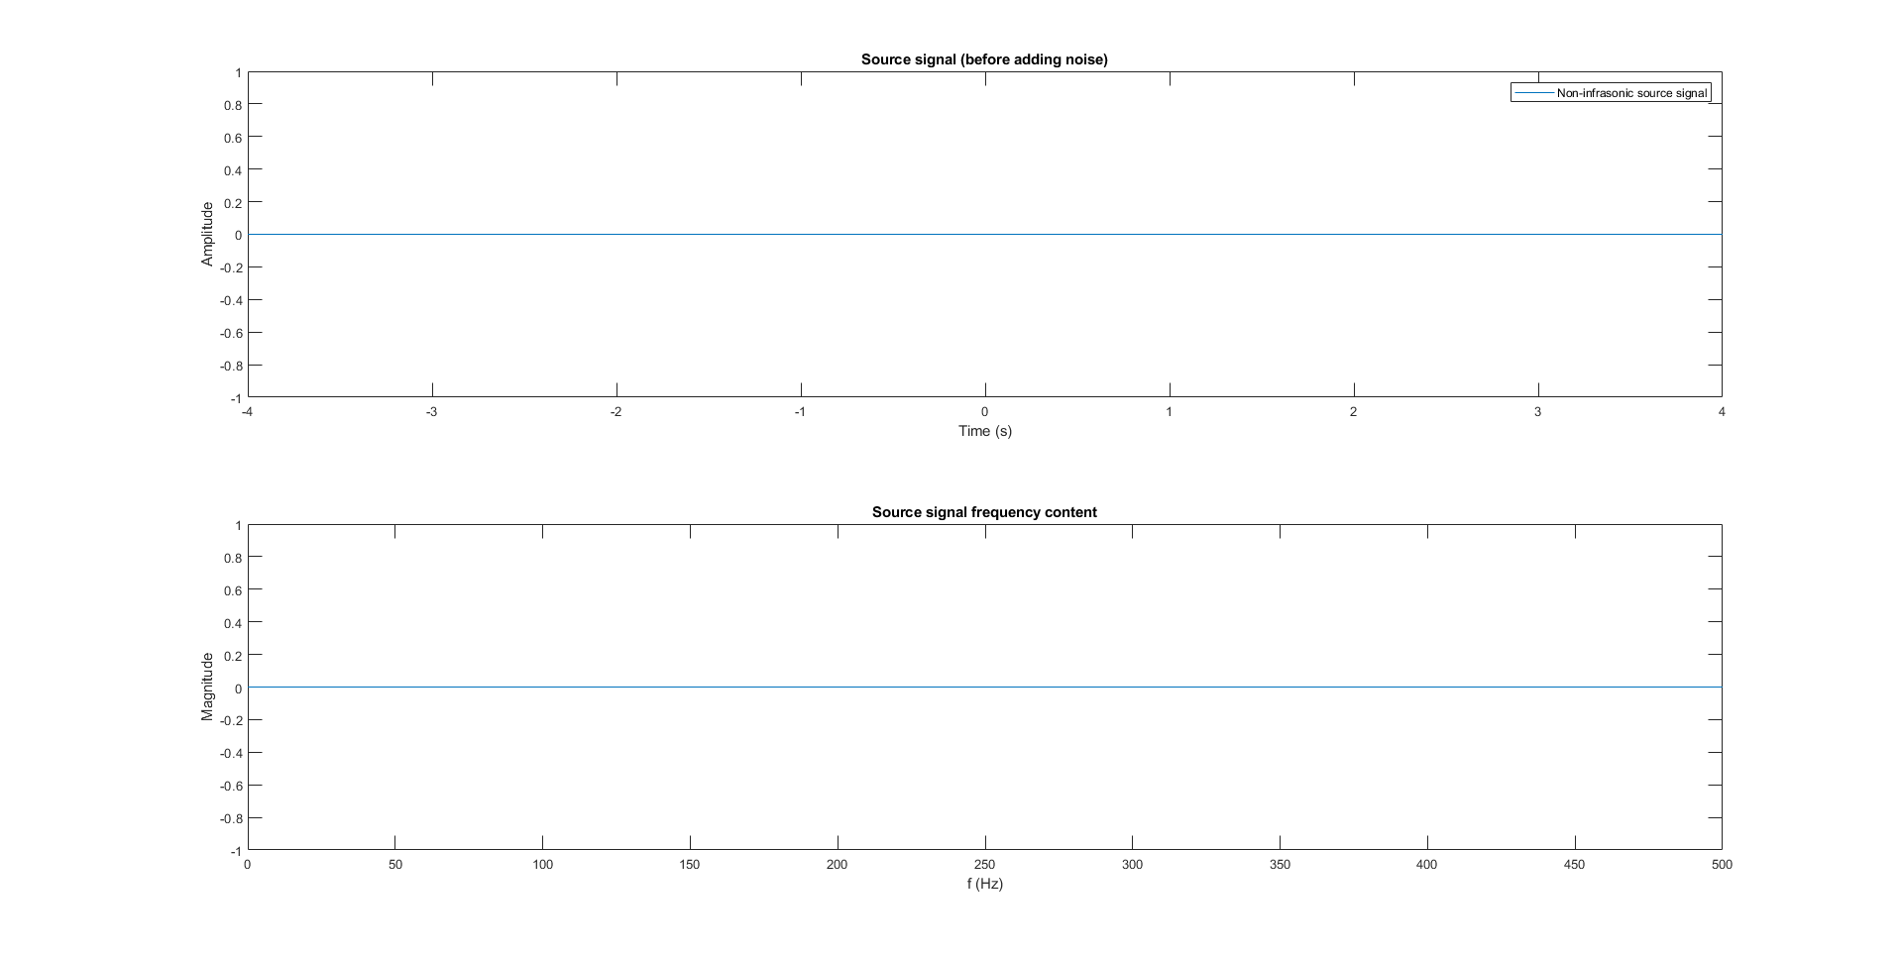
Detection test case: infrasonic signal absent

Slide 33
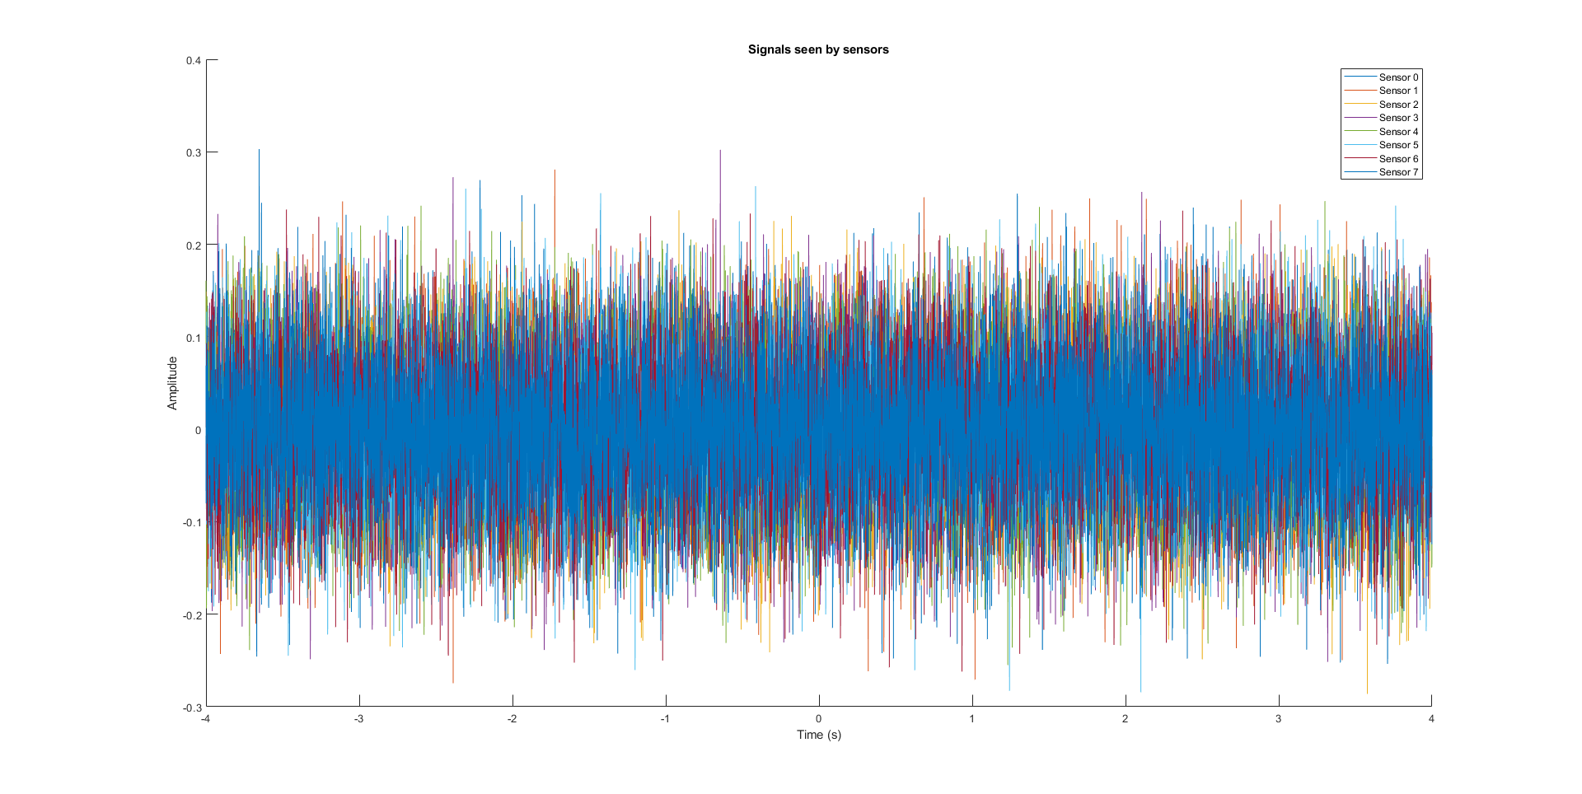
Sensor data

Slide 34
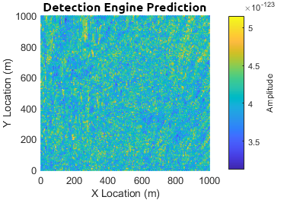
Heatmap output

Slide 35
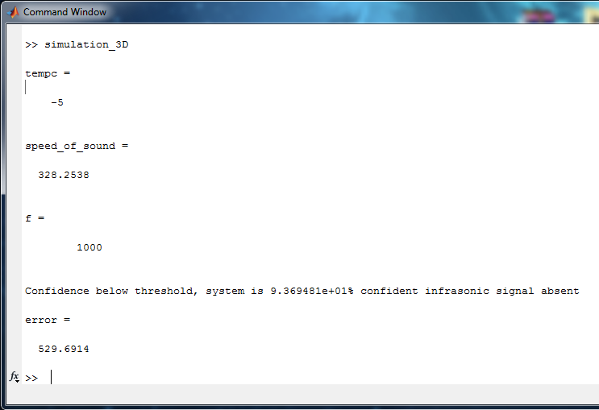
Results
System correctly predicted the absence of an infrasonic signal

Slide 36
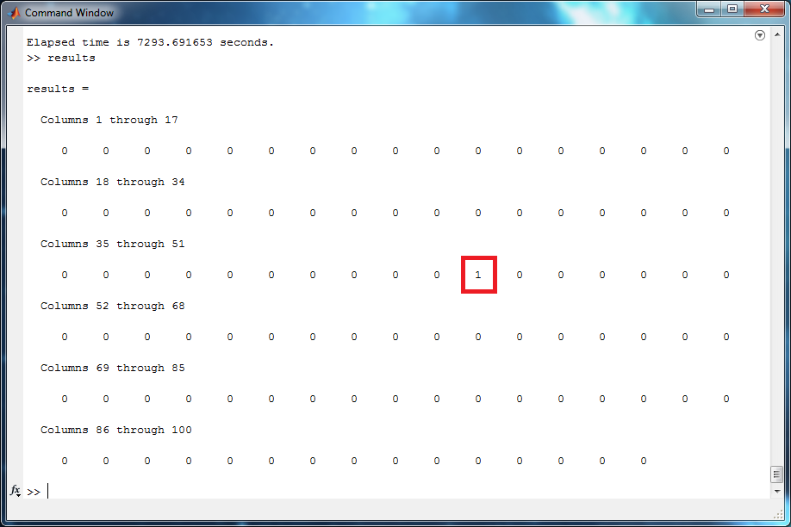
Study of 100 signal absent simulations
99 of the 100 simulations correctly identified signal absence
There was 1 false positive

Slide 37
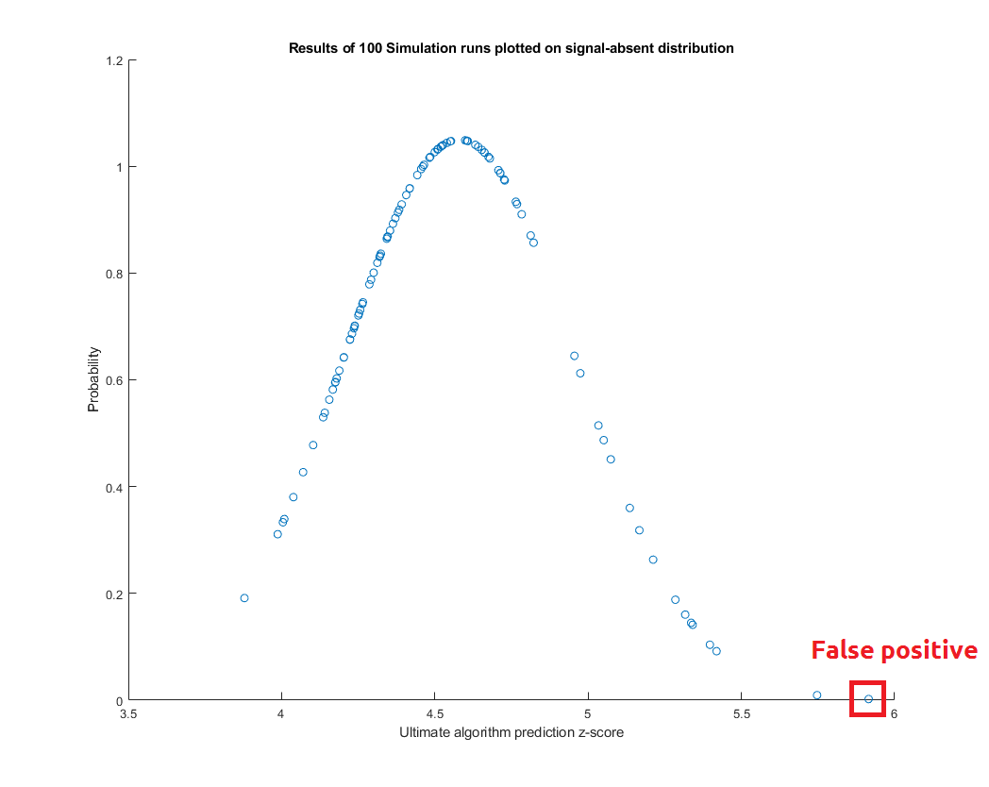

Slide 38
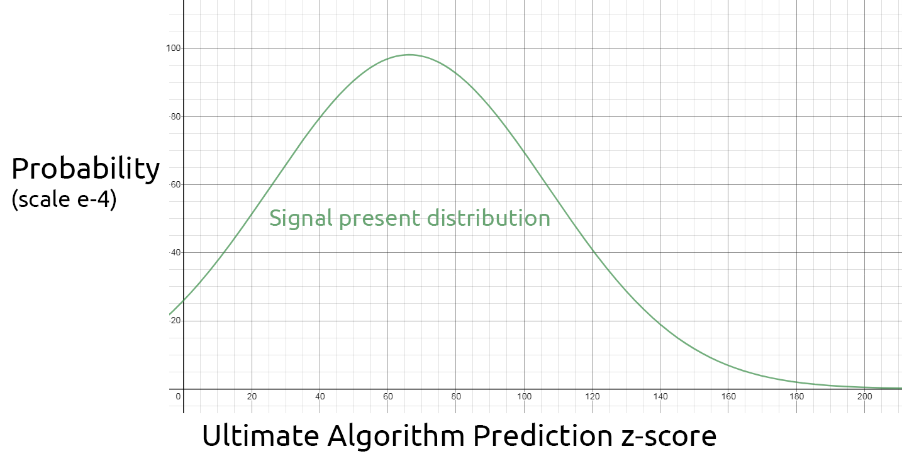
Appendix

Slide 39
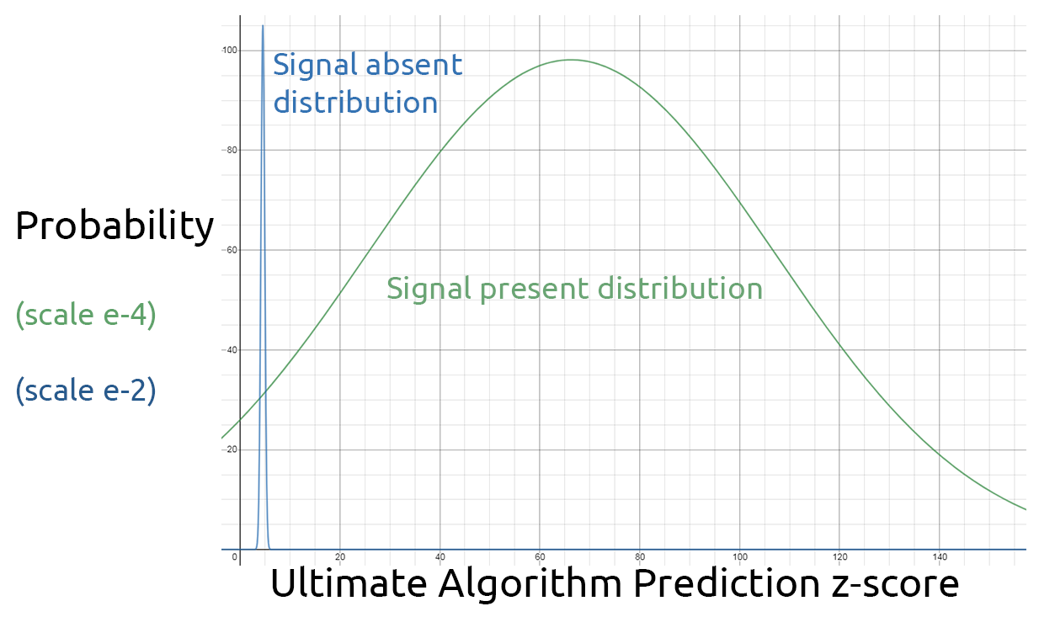

Slide 40
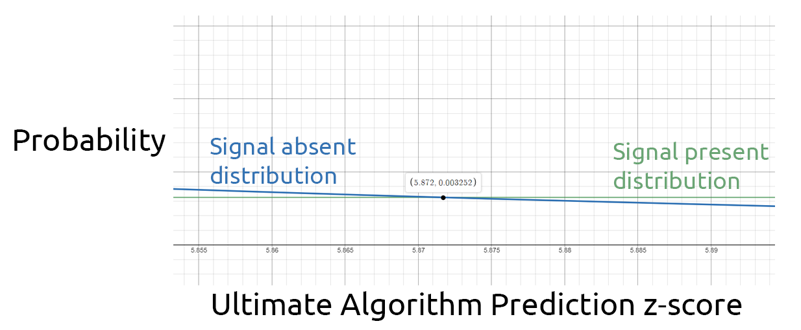

Slide 41
Detection threshold
max_z = (max - avg)/dev; if(max_z >= 5.872) prob = normcdf(max_z,4.58,0.38) * 100; fprintf('Confidence threshold exceeded, system is %d',prob) disp('% confident infrasonic signal present') detection = true; else prob = (1 - (normcdf(max_z,66.29,40.65)))*100; fprintf('Confidence below threshold, system is %d',prob) disp('% confident infrasonic signal absent'); detection = false; end

Slide 42
Algorithm Implemtation
%% Signal Processing Algorithm Definition function [heatmap] = predict(heatmap_in,f,signal0,signal1,grid,s0,s1,speed) x = []; y = []; z = []; heatmap = cell(150,150); % Iterate through all grid points for i = 1:150 for k = 1:150 % Calculate distance from current grid point to each sensor distance0 = distance(s0,grid{i,k}); distance1 = distance(s1,grid{i,k}); % Determine difference in distance to reach sensor 1-3 compared % to reference sensor 0 delta_1 = distance1 - distance0; % Calculate wavelength from speed of sound wave_length = speed/10; | % Calculate phase shifts from wavelength shift_1 = delta_1/wave_length; % Shift signals 1-3 accordingly, in attempt to match signal 0 signal1_shift = circshift(signal1,round(-shift_1.*f/10)); % Sum signals beamformed = signal0 .* signal1_shift; % Calculate root mean square amplitude amplitude = mean(sqrt(beamformed.^2)); heatmap{i,k} = amplitude .* heatmap_in{i,k}; end end end

